Slide 1
ADVANCED GRAPHIC DESIGN
PHOTOSHOP 2020
Presented By
Andrew Stretton
C
C
C
P
March 2020
P

Slide 2

CONTENTS
ADVANCED PHOTOSHOP 2020
TOOLS
1. SELECTION TOOLS |  |  |  |  |  |  |  |  |  |  |  |  |  |  |  | 4. RE-TOUCHING TOOLS
1. | Move Tool |  |  |  |  |  |  |  |  |  |  |  |  |  |  | 8. | Spot Healing Brush Tool |  |  |  |  |  |  |  |  |  |  |  |  | 12.4 | Color Replacement Tool |  |  | 15.4 | Line Tool
1.1 | Artboard Tool |  |  |  |  |  |  |  |  |  |  |  |  |  |  | 8.1 | Healing Brush Tool |  |  |  |  |  |  |  |  |  |  |  |  | 12.5 | History Brush Tool |  |  | 15.5 | Custom Shape Tool
2. | Rectangular Marquee Tool |  |  |  |  |  |  |  |  |  |  |  |  |  |  | 8.2 | Patch Tool |  |  |  |  |  |  |  |  |  |  |  |  | 12.6 | Gradient Tool |  |  | 16. | Path Selection Tool
2.1 | Elliptical Marquee Tool |  |  |  |  |  |  |  |  |  |  |  |  |  |  | 8.3 | Content-Aware Move Tool |  |  |  |  |  |  |  |  |  |  |  |  | 6. DRAWING TOOLS |  |  |  | 16.1 | Direct Selection Tool
3. | Lasso Tool |  |  |  |  |  |  |  |  |  |  |  |  |  |  | 8.4 | Red Eye Tool |  |  |  |  |  |  |  |  |  |  |  |  | 13. | Pen Tool |  |  | 8. NAVIGATION TOOLS
3.1 | Polygonal Lasso Tool |  |  |  |  |  |  |  |  |  |  |  |  |  |  | 9. | Clone Stamp Tool |  |  |  |  |  |  |  |  |  |  |  |  | 13.1 | Freeform Pen Tool |  |  | 17. | Hand Tool
3.2 | Magnetic Lasso Tool |  |  |  |  |  |  |  |  |  |  |  |  |  |  | 9.1 | Pattern Stamp Tool |  |  |  |  |  |  |  |  |  |  |  |  | 13.2 | Curvature Pen Tool |  |  | 17.1 | Rotate Tool
4. | Quick Selection Tool |  |  |  |  |  |  |  |  |  |  |  |  |  |  | 10. | Eraser Tool |  |  |  |  |  |  |  |  |  |  |  |  | 13.3 | Add Anchor Point Tool |  |  | 17.2 | Zoom Tool
4.1 | Magic Wand Tool |  |  |  |  |  |  |  |  |  |  |  |  |  |  | 10.1 | Background Eraser Tool |  |  |  |  |  |  |  |  |  |  |  |  | 13.4 | Delete Anchor Point Tool
4.2 | Frame Tool |  |  |  |  |  |  |  |  |  |  |  |  |  |  | 10.2 | Magic Eraser Tool |  |  |  |  |  |  |  |  |  |  |  |  | 13.5 | Convert Point Tool
2. CROP TOOLS OL TOOL |  |  |  |  |  |  |  |  |  |  |  |  |  |  |  | 11. | Smudge Tool |  |  |  |  |  |  |  |  |  |  |  |  | 7. TYPE & DRAWING TOOLS
5. | Crop Tool |  |  |  |  |  |  |  |  |  |  |  |  |  |  | 11.1 | Dodge Tool |  |  |  |  |  |  |  |  |  |  |  |  | 14. | Horizontal Type Tool
5.1 | Perspective Crop Tool |  |  |  |  |  |  |  |  |  |  |  |  |  |  | 11.2 | Burn Tool |  |  |  |  |  |  |  |  |  |  |  |  | 14.1 | Vertical Type Tool
3. COLORS & MEASURES TOOLS |  |  |  |  |  |  |  |  |  |  |  |  |  |  |  | 11.3 | Sponge Tool |  |  |  |  |  |  |  |  |  |  |  |  | 14.2 | Vertical Type Mask Tool
6. | Eyedropper Tool |  |  |  |  |  |  |  |  |  |  |  |  |  |  | 5. PAINTING TOOLS |  |  |  |  |  |  |  |  |  |  |  |  |  | 14.3 | Horizontal Type Mask Tool
6.1 | Color Sampler Tool |  |  |  |  |  |  |  |  |  |  |  |  |  |  | 12. | Pencil Tool |  |  |  |  |  |  |  |  |  |  |  |  | 15. | Rectangle Tool
7. | Ruler Tool |  |  |  |  |  |  |  |  |  |  |  |  |  |  | 12.1 | Mixer Brush Tool
 |  |  |  |  |  |  |  |  |  |  |  |  |  |  |  |  |  |  |  |  |  |  |  |  |  |  |  |  |  | 15.1 | Rounded Rectangle Tool
7.1 | Note Tool |  |  |  |  |  |  |  |  |  |  |  |  |  |  | 12.2 | Brush Tool |  |  |  |  |  |  |  |  |  |  |  |  | 15.2 | Ellipse Tool
7.2 | Count Tool |  |  |  | 1 |  |  |  |  |  |  |  |  |  |  | 12.3 | Paint Bucket Tool |  |  |  |  |  |  |  |  |  |  |  |  | 15.3 | Polygon Tool
CONTENTS
CONTENTS
CONTENTS
Please Select Any
Yellow Hyperlinked Text
For Guidance &
Screen Print Examples
Thank You

Slide 3
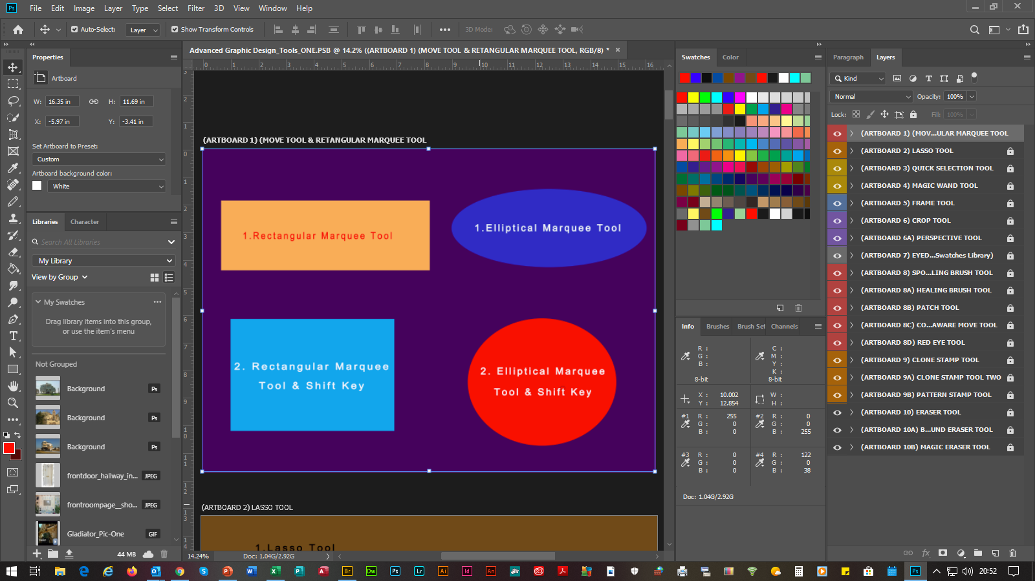
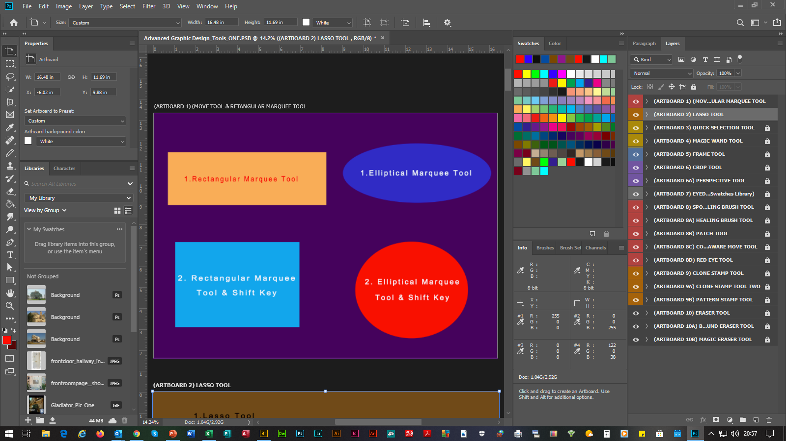
ADVANCED PHOTOSHOP 2020
Photoshop Is A (Raster Graphics), RASTER GRAPHICS Editor, I.E. File Types: (BMP), (Bitmap),
(TIFF & TIF), Tag Image File Format, (GIF), Graphics Interchange Format, (PNG), Portable Network Graphic & (JPEG), Joint Photographic Experts Group.
(SLIDE 1) |  |  | (1. SELECTION TOOLS)
1. | Move Tool |  |  | Moves Shapes Around The Canvas. Can Also Re-Size Squares, Circles, Ovals, Etc, By Selecting The CTRL KEY & T, Which Will Bring Up The Show Transform Controls Options Within The Options Bar, Then Select A Point & Drag The Left Handle Of The Mouse. For Re-Shaping Keep The CTRL KEY Enabled & Drag The Left Handle Of The Mouse. Vertical & Horizontal Guides Can Be Used By Selecting Either The Vertical Or Horizontal Ruler & Dragging The Left Handle Of The Mouse Into The Canvas.
 | 1.1 | Artboard Tool |  |  | Allows You To Add Artboards By Selecting Any Of The + Symbols Positions Or Duplicate By Selecting The ALT KEY & Any Of The + Symbols. To Arrange Artboards Vertically Or Horizontally, Select The Artboards Names Above The Canvas & Drag The Left Handle Of The Mouse. Further Actions Are Available By Selecting The Artboards Name Within The Layers Panel, Then Selecting The Right Handle Of The Mouse. To Name Or Re-Name, Double Click The Artboards Name Within The Layers Panel.
C
C
C
P
P

Slide 4
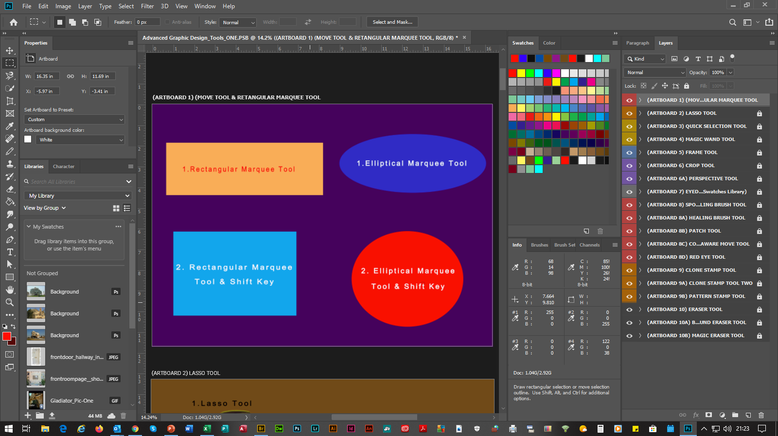
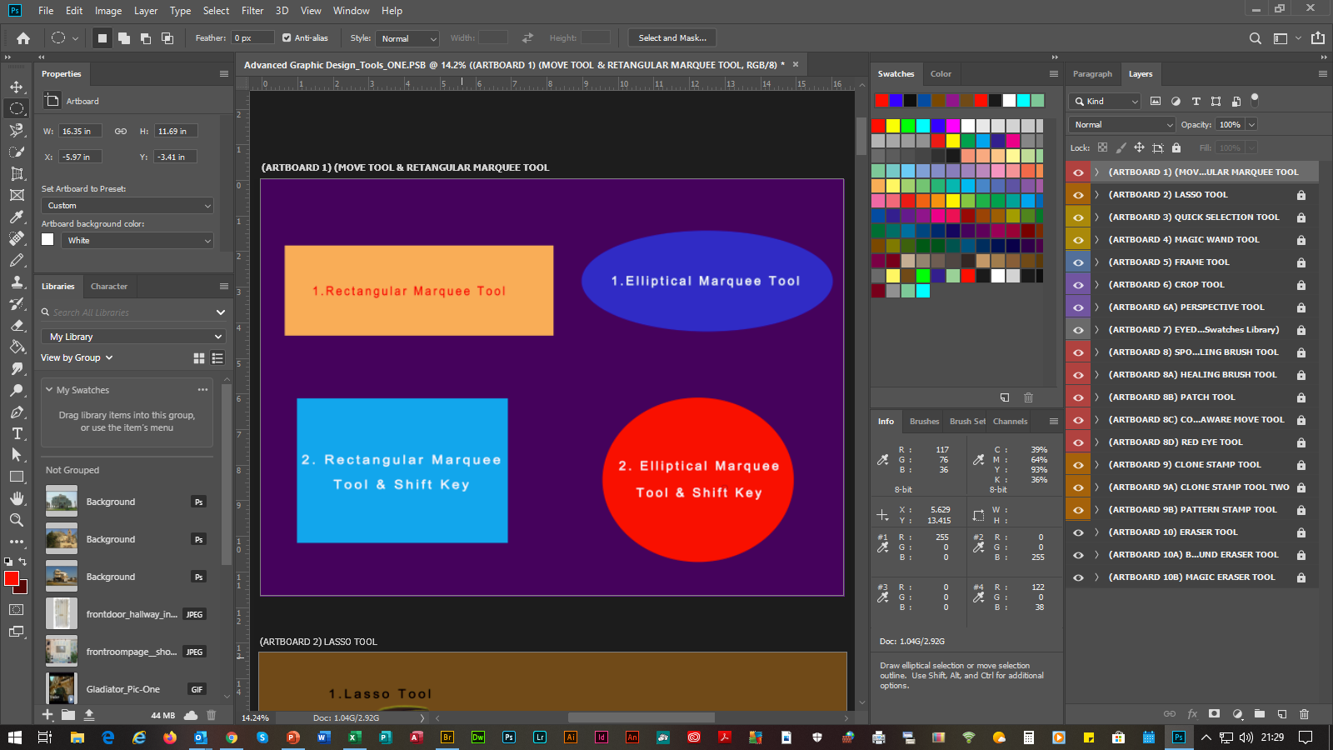
ADVANCED PHOTOSHOP 2020
(SLIDE 2) |  |  | (1. SELECTION TOOLS)
2. | Rectangular Marquee Tool |  |  | Makes Rectangular & Square Selections Around Text, Graphics, Pictures & Photographs For Editing. Can Also Be Used For Color Fills & Gradient Overlays, Using The (fx Function Button’s Options). To Re-Shape, Select The CTRL KEY & T, Which Will Bring Up The Show Transform Controls Options Within The Options Bar, Then The CTRL KEY, Then Drag The Left Handle Of The Mouse. Or Select Edit From The Menu Bar, Then From The Transform Path Options Selections Select: Again, Scale, Rotate Or Skew. To Draw A Square Shape, Select The SHIFT KEY & Drag The Left Handle Of The Mouse Near The Top/Bottom Or Right/Left Areas.
 | 2.1 | Elliptical Marquee Tool |  |  | Makes Oval & Circle Selections Around Text, Graphics, Pictures & Photographs For Editing. Can Also Be Used For Color Fills & Gradient Overlays, Using The (fx Function Button’s Options). To Re-Shape, Select The CTRL KEY & T, Which Will Bring Up The Show Transform Controls Options Within The Options Bar, Then The CTRL KEY, Then Drag The Left Handle Of The Mouse. Or Select Edit From The Menu Bar, Then From The Transform Path Options Selections Select: Again, Scale, Rotate Or Skew. To Draw A Circle Shape, Select The SHIFT KEY & Drag The Left Handle Of The Mouse Near The Top/Bottom Or Right/Left Areas. (Example Included With Above Screen Print) (Example Included With Above Screen Print)
C
C
C
P
P

Slide 5
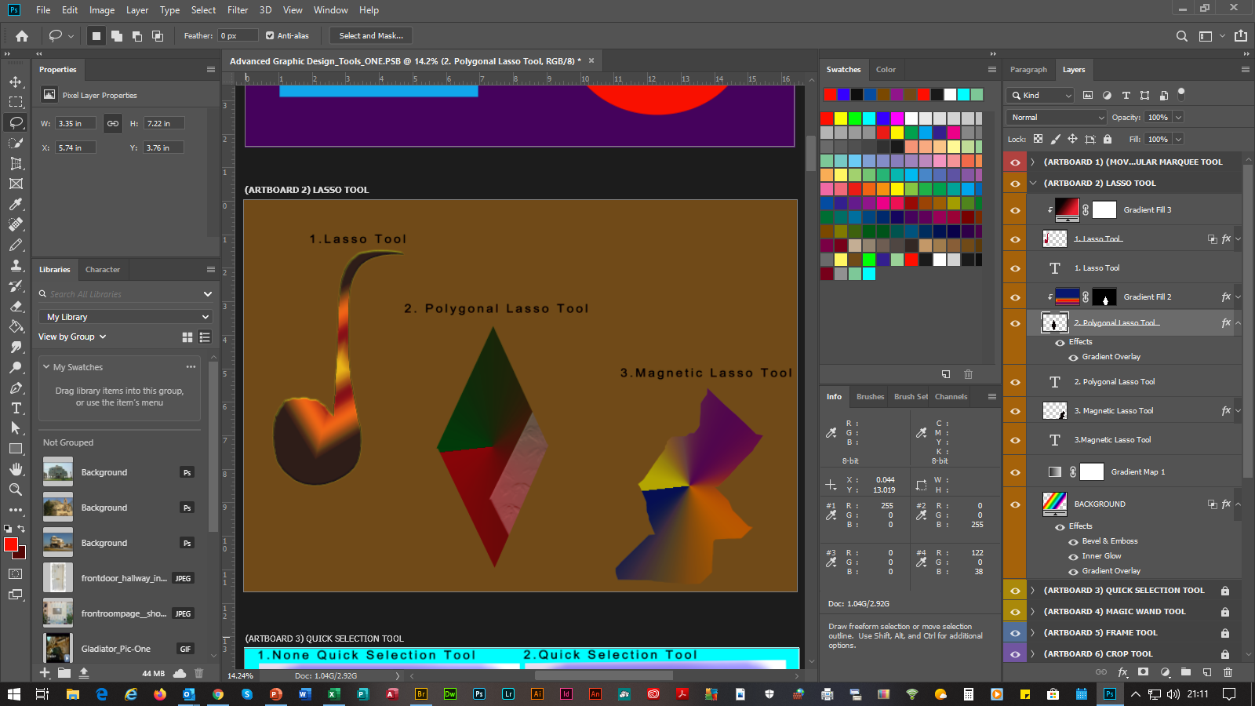
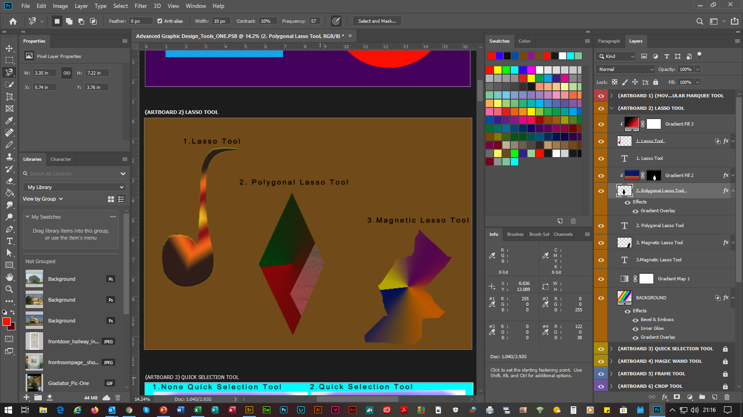
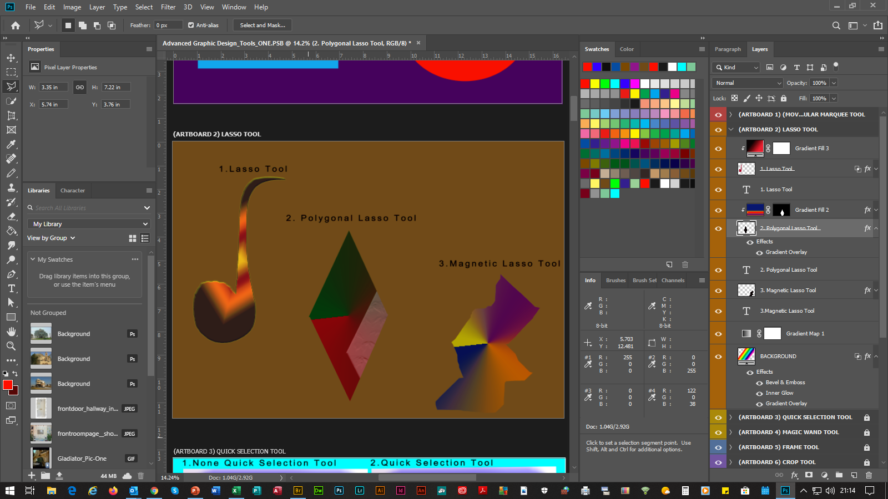
ADVANCED PHOTOSHOP 2020
(SLIDE 3) |  |  | (1. SELECTION TOOLS)
3. | Lasso Tool |  |  | Makes Freehand Selections Around Text, Graphics, Pictures & Photographs For Editing. Can Also Be Used For Color Fills & Gradient Overlays, Using The (fx Function Button’s Options). To Re-Shape, Select The CTRL KEY & T, Which Will Bring Up The Show Transform Controls Options Within The Options Bar, Then The CTRL KEY, Then Drag The Left Handle Of The Mouse. Or Select Edit From The Menu Bar, Then From The Transform Path Options Selections Select: Again, Scale, Rotate Or Skew.
 | 3.1 | Polygonal Lasso Tool |  |  | Makes Straight Selections Around Text, Graphics, Pictures & Photographs For Editing. Can Also Be Used For Color Fills & Gradient Overlays, Using The (fx Function Button’s Options). To Re-Shape, Select The CTRL KEY & T, Which Will Bring Up The The Show Transform Controls Options Within The Options Bar, Then The CTRL KEY, Then Drag The Left Handle Of The Mouse. Or Select Edit From The Menu Bar, Then From The Transform Path Options Selections Select: Again, Scale, Rotate Or Skew.
 | 3.2 | Magnetic Lasso Tool |  |  | Makes Magnetic Snap-To Selections. To Apply & Use Follow 3. Lasso Tool & 3.1 Polygonal Lasso Tool’s Procedures. (Examples Included With Above Screen Print)
C
C
C
P
P

Slide 6
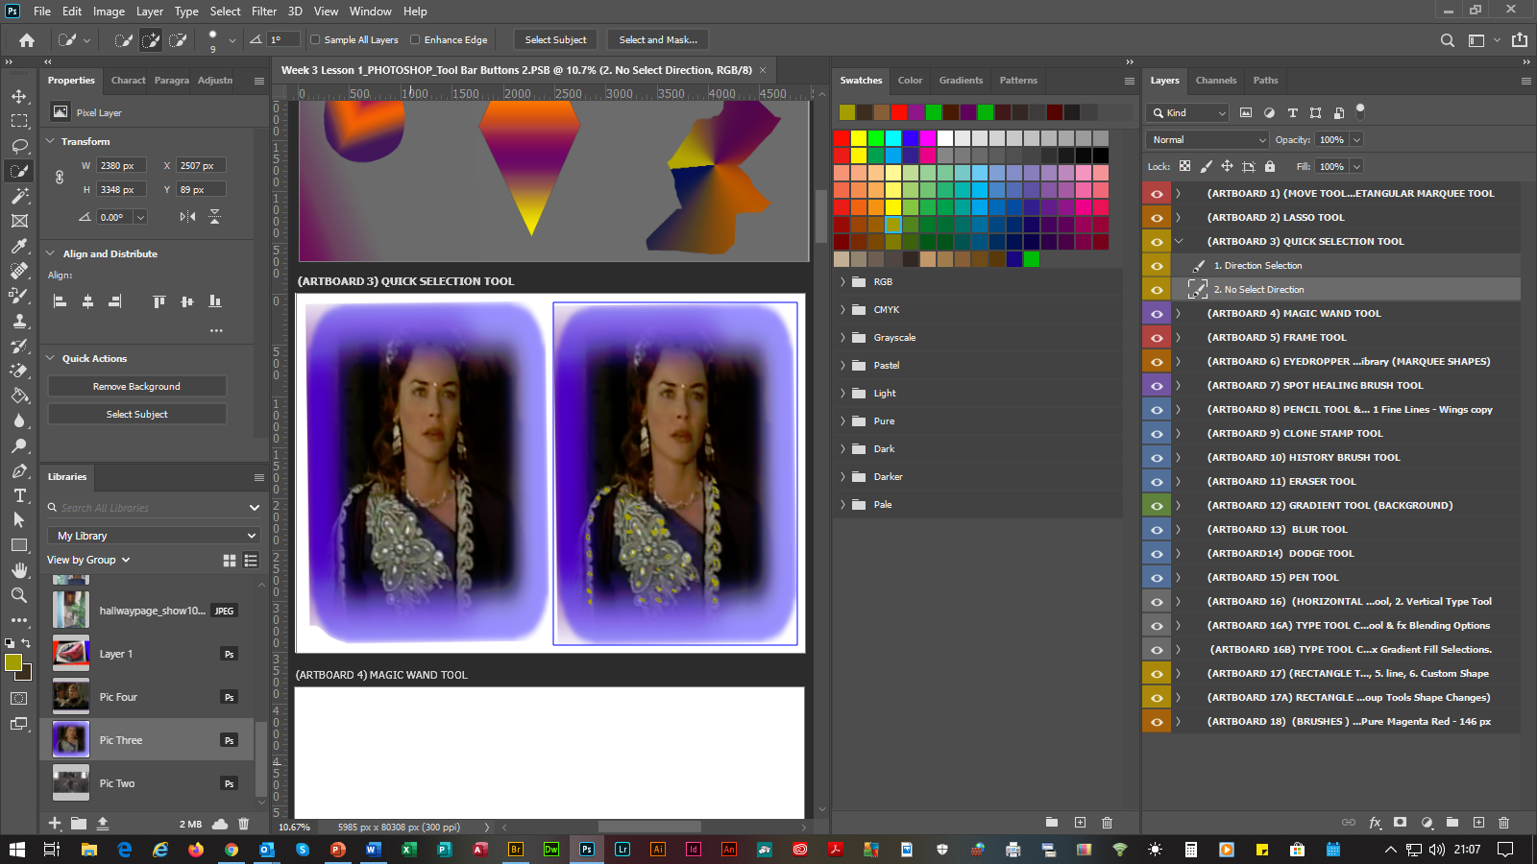
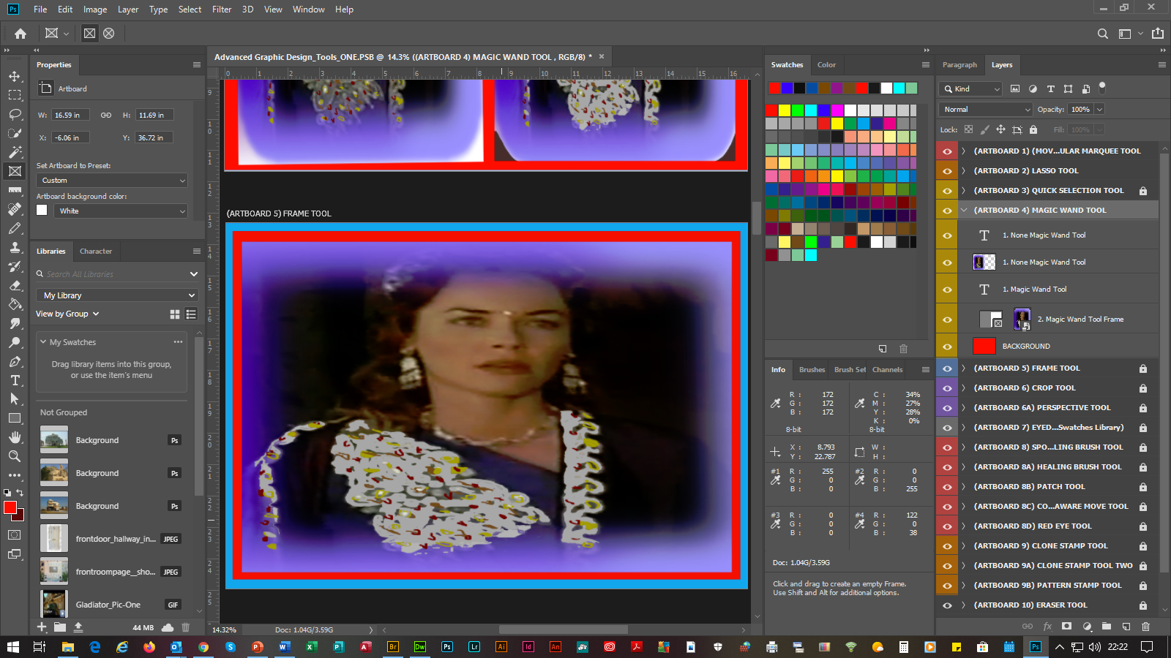
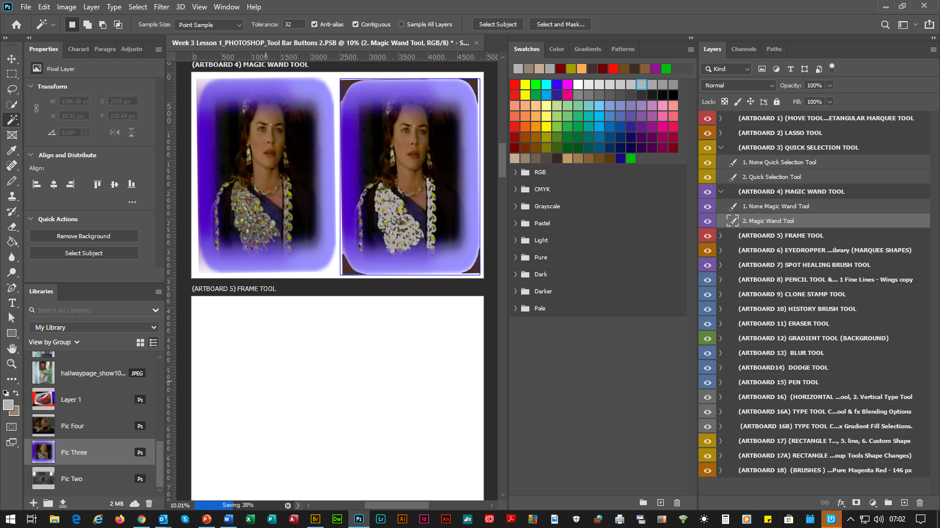
ADVANCED PHOTOSHOP 2020
(SLIDE 4) |  |  | (1. SELECTION TOOLS)
4. | Quick Selection Tool |  |  |  | Makes Edge Selections To Graphics, Pictures & Photographs For Editing, By Using An Adjustable Round Brush Tip, Which Is Controlled From The Options Bar. To Enable The Brush Tool, Select Edit From The Menu Bar, Then Preferences, Then From The Preferences List Select Cursors, Which Will Bring Up The Preferences Dialog Box, Then From The Pointing Cursors Selections, Select The Standard Radio Button, Then Select The Show Brush Leash While Smoothing Check-Box, Then Select The Brush Leash Color Button, Which Will Bring Up The Color Picker Dialog Box ,With Choices From The (Brush Leash Color) Selections, Then Select A Desired Color, Then Select The OK Button, Then Select The OK Button Again.
 | 4.1 | Magic Wand Tool |  |  |  | Makes Similar Enhancements Like The Quick Selection Tool & Is Controlled From The Options Bar. N.B. The Above Brush Is Not Available For This Tool. (Example Included With Above Screen Print)
 | 4.2 | Frame Tool |  | Makes Square/Rectangular & Circular/Oval Placeholder Frames For Scanned Drawings & Photographs, Which Can Be Converted Vise Versa By Inserting Or Dragging The Image(s) Into The Frame From The Library’s Panel.
C
C
C
P
P

Slide 7
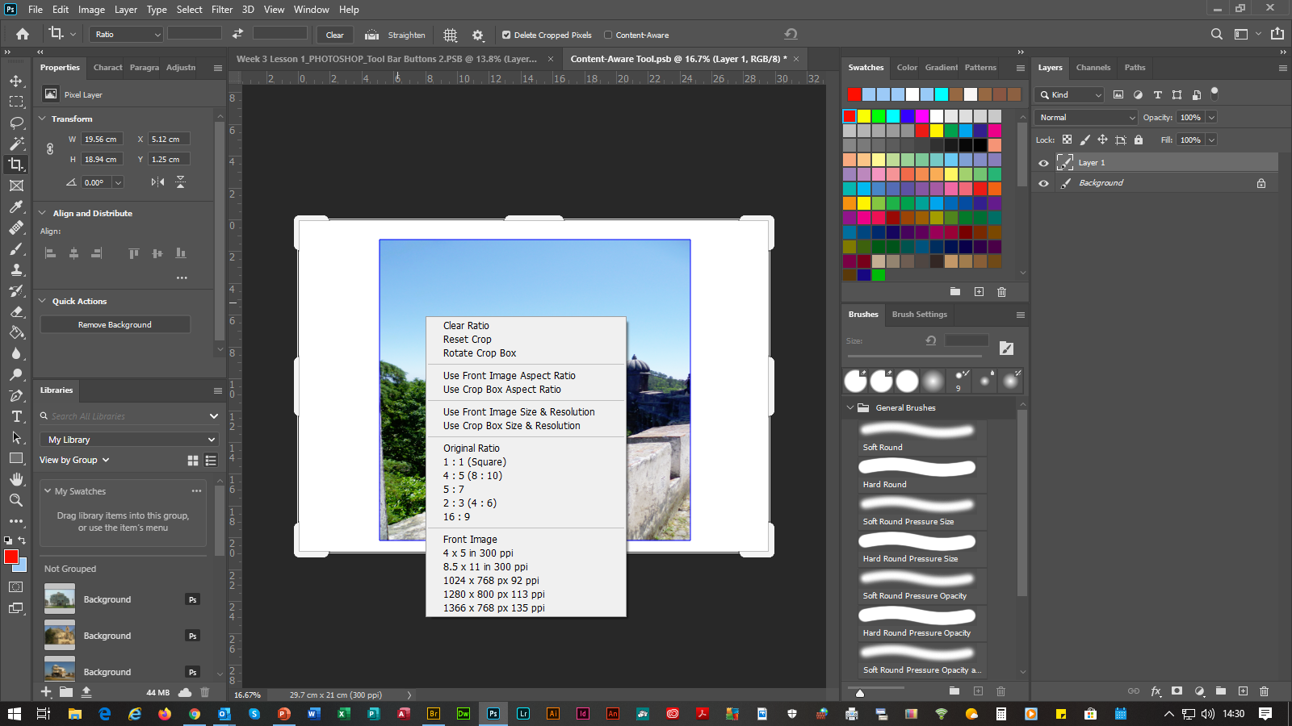
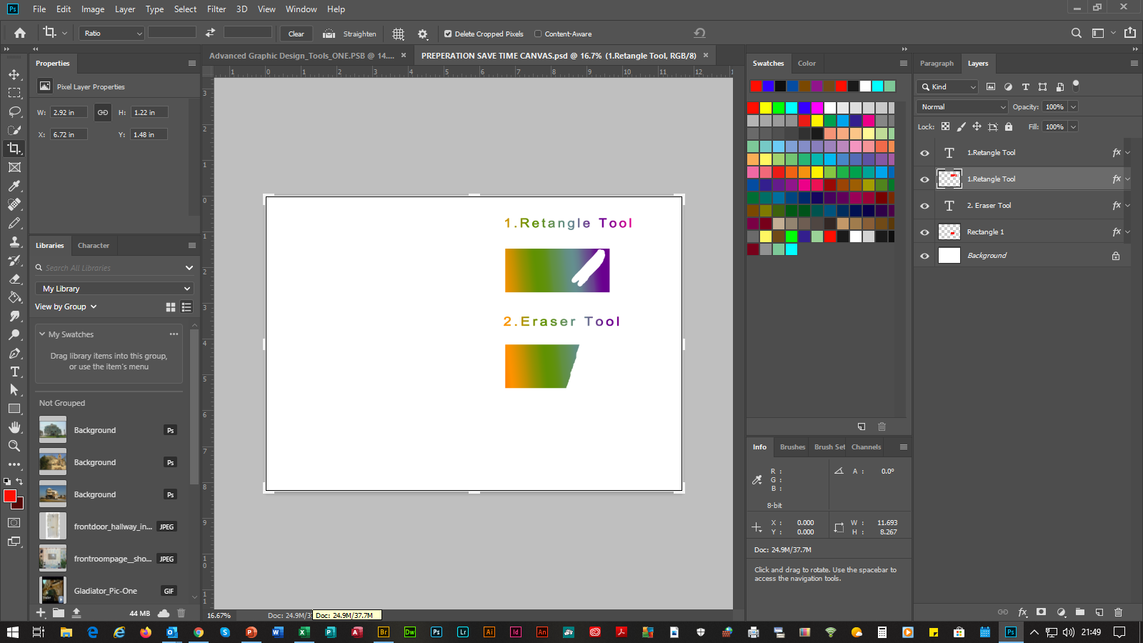
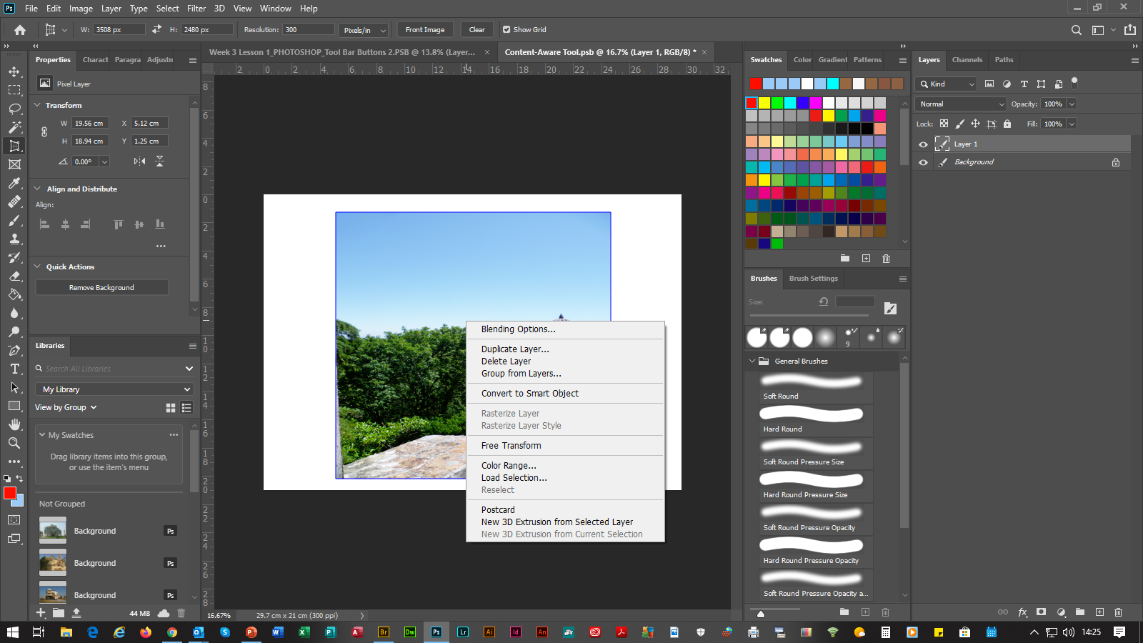
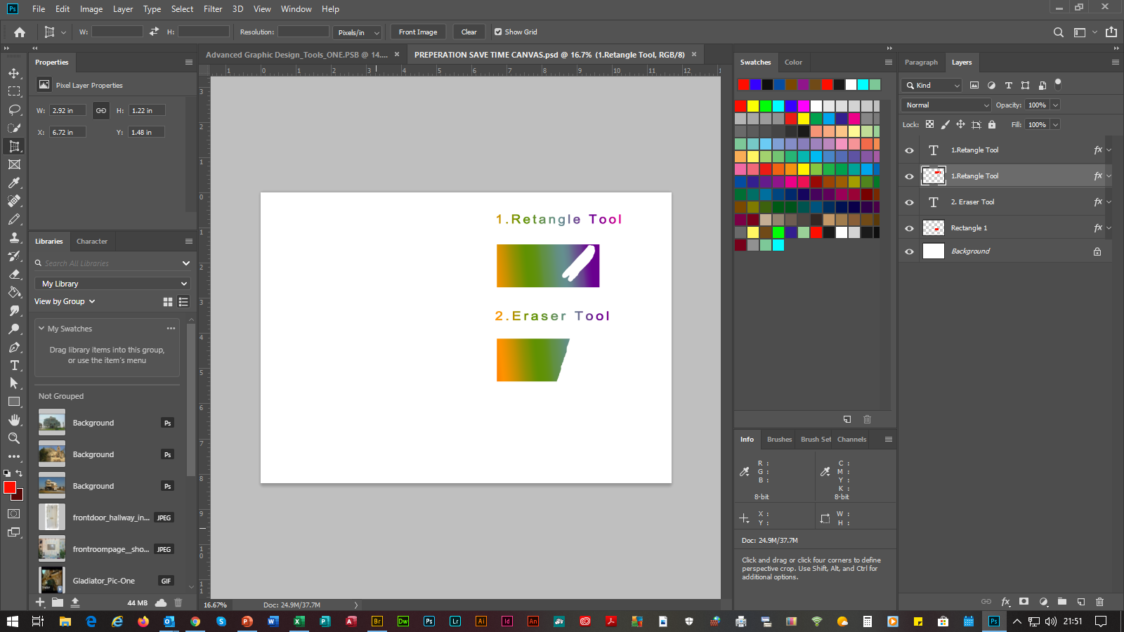
ADVANCED PHOTOSHOP 2020
(SLIDE 5) |  |  | (2. CROP TOOLS)
5. | Crop Tool |  |  | Makes Crop Selections To Scanned Drawings & Photographs. N.B. To Change Settings, Select The Right Handle Of The Mouse, Which Will Bring Up The Crop Tool’s Dialog Box.
 | 5.1 | Perspective Crop Tool |  |  | Makes Perspective Crop Selections To Scanned Drawings & Photographs. N.B. Always Rasterize The Layer First By Selecting Layer From The Menu Bar, Then Rasterize, Then From The Rasterize List Select Layer. Secondly, You Can Rasterize By Selecting The Layer Within The Layers Panel, Then Selecting The Right Handle Of The Mouse, Then From The List, Select Rasterize Layer. It Is Also Possible To Make Color Alterations, Etc, By Selecting The Right Handle Of The Mouse, Which Will Bring Up The Perspective Crop Tool’s Dialog Box.
C
C
C
P
P

Slide 8
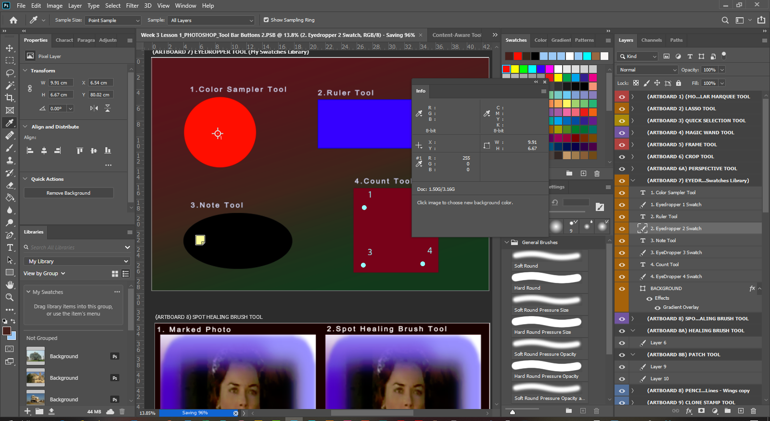
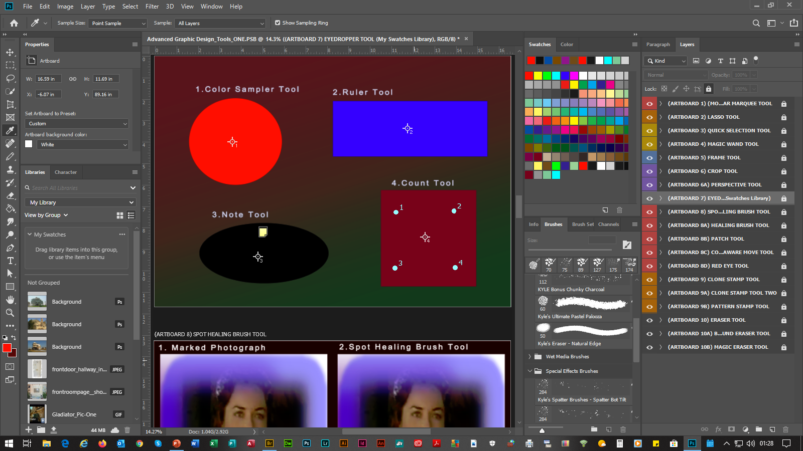
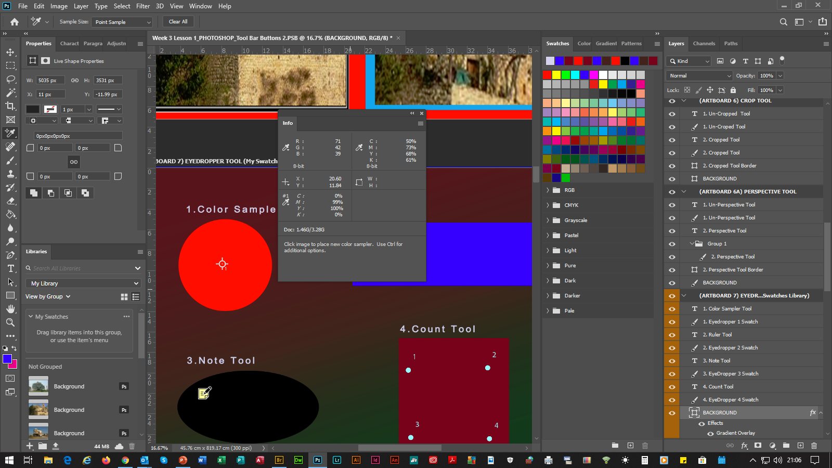
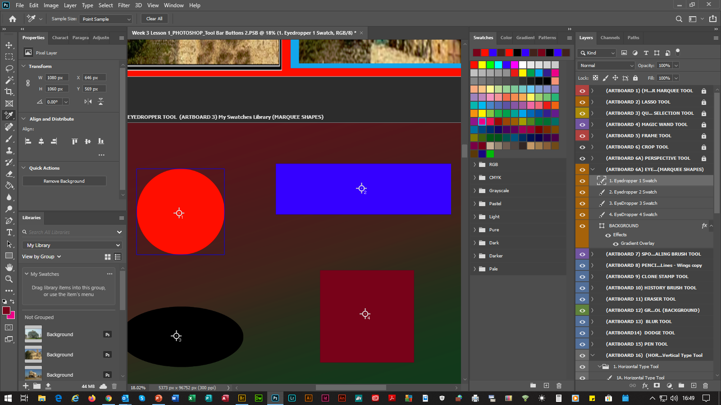
ADVANCED PHOTOSHOP 2020
(SLIDE 6) |  |  | (3. COLORS & MEASURES TOOLS)
6. | Eyedropper Tool |  |  | Adds Colors To The Swatches Tab’s Color Selections Within The Swatches Panel & Displays Them Within The Info Panel, By Moving The Circular Crosshair Over The Color, Then Selecting The Left Handle Of The Mouse, Which Will Enable The Large Color Sampler To Add The Color. Or, By Selecting The Left Handle Of The Mouse, Moving The Large Color Sampler Over Each Color & Then Releasing The Left Handle Of The Mouse.
 | 6.1 | Color Sampler Tool |  |  | Displays Each Shapes Color Values For Up To 4 Areas & Displays Them Within The Info Panel, By Moving The Crosshair Of The Mouse Over Each Color, Then Selecting The Left Handle Of The Mouse, Which Will Enable A Color Sampler Circle Crosshair. To Delete A Color Sample Select The Right Handle Of The Mouse & Select Delete. Or, To Delete All, Select The Clear All Button Within The Options Bar. N.B. There Is A Maximum Of Ten Color Samplers. To Un-Reveal The Color Samplers, Select The Move Tool, Then To Reveal Them At Any Time, Select The Color Sampler Tool Again. (Example Included With Above Screen Print)
C
C
C
P
P

Slide 9
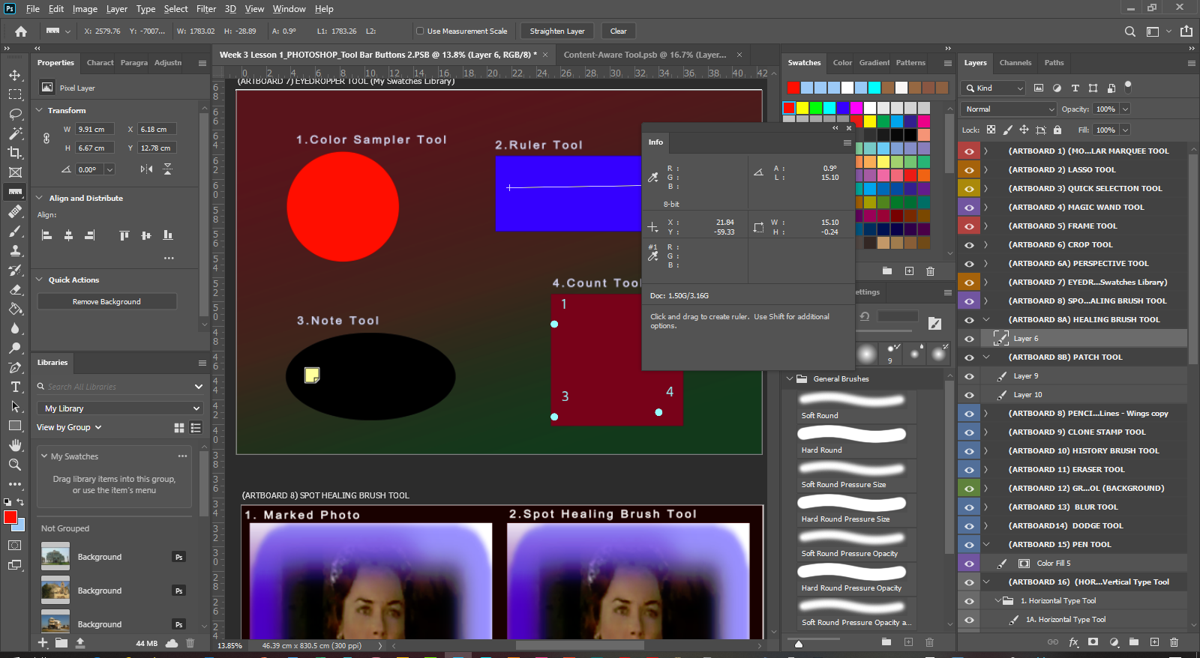
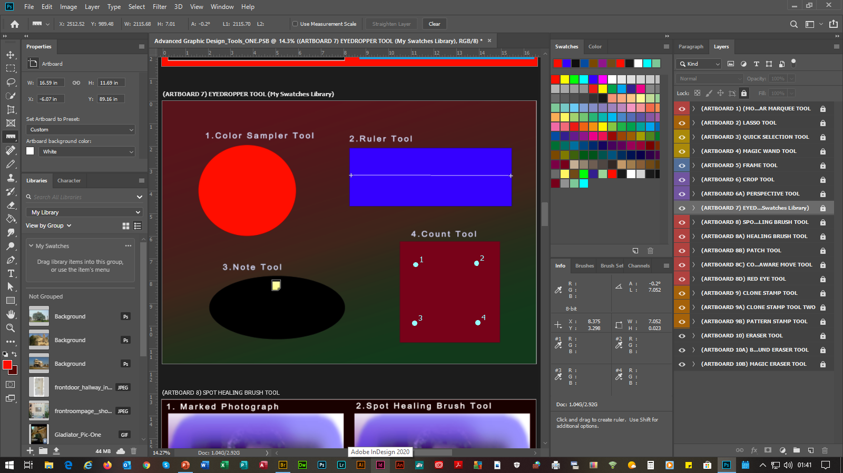
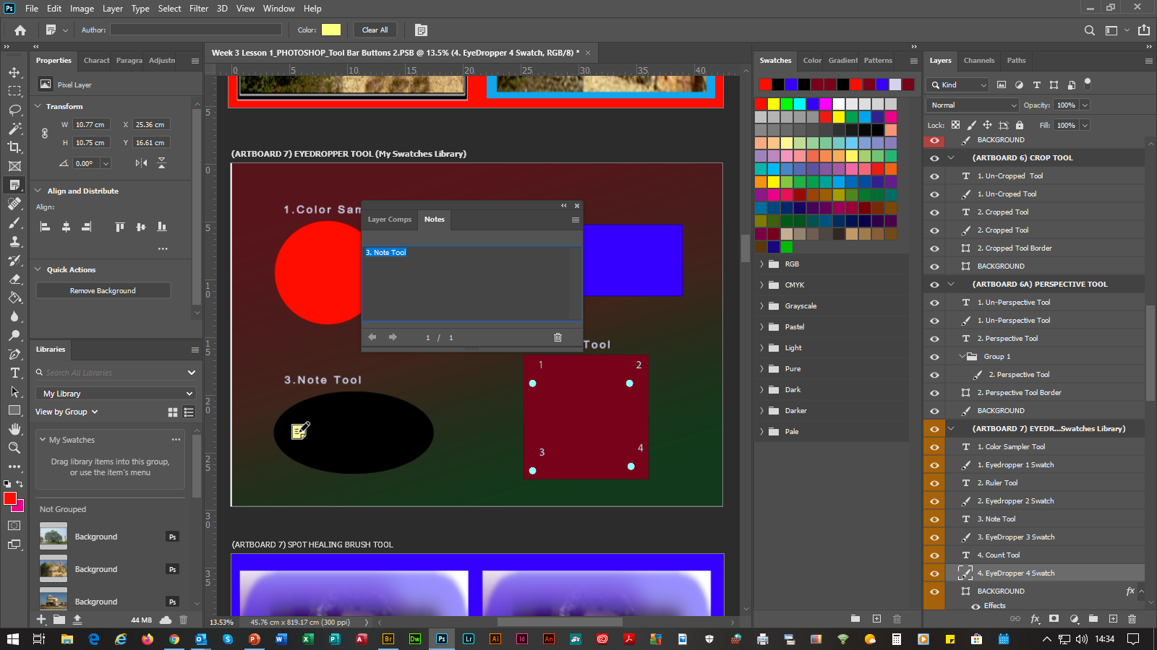
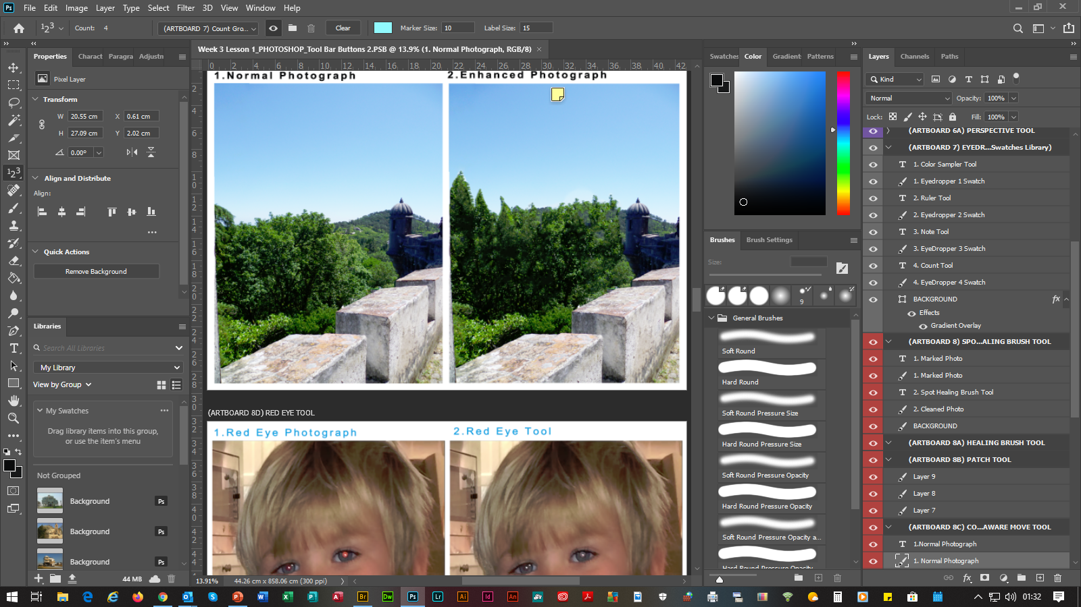
ADVANCED PHOTOSHOP 2020
(SLIDE 7) |  |  | (3. COLORS & MEASURES TOOLS)
7. | Ruler Tool |  |  | Measures Distances, Locations & Angles To Any Object Within The Canvas, Which Are Displayed Within The Info Panel, By Moving The Crosshair Over The Shape & Implementing A Line Measurer.
 | 7.1 | Note Tool |  |  | Enables Notes To Be Attached To Shapes & Photographs, Which Can Be Typed & Viewed Within The Notes Panel. To Review The Note, Double Click On The Note. To Delete A Note, Select The Right Handle Of The Mouse & Select Delete Or Delete All.
 | 7.2 | Count Tool |  | Displays Counts Within Shapes & Photographs. (Examples Included With Above Screen Print) | Displays Counts Within Shapes & Photographs.
C
C
C
P
P

Slide 10
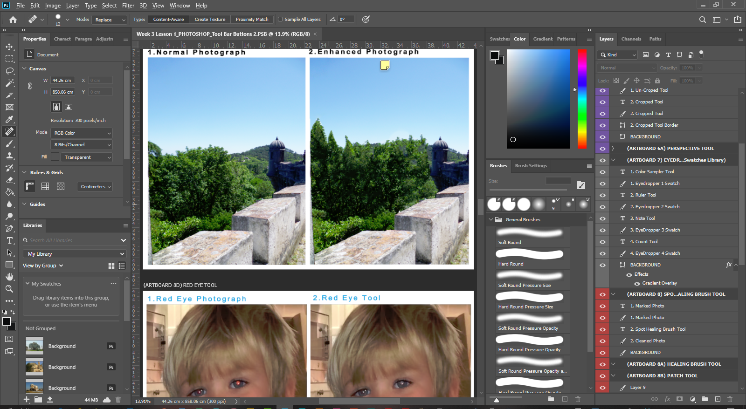
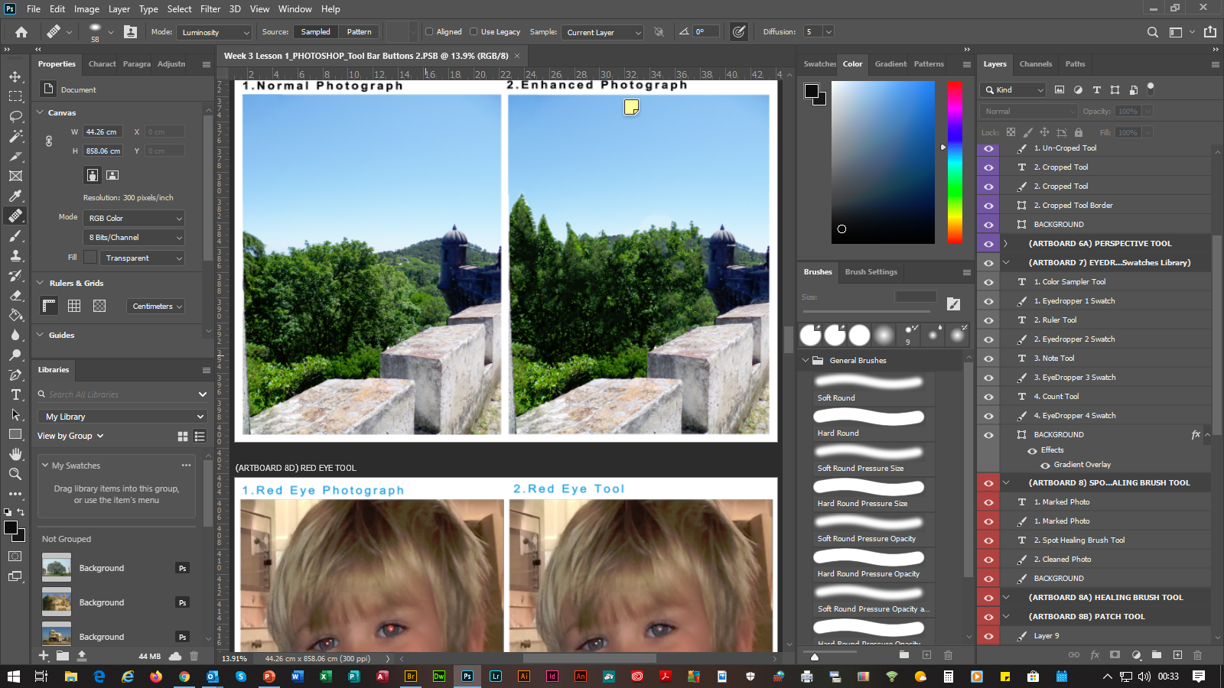
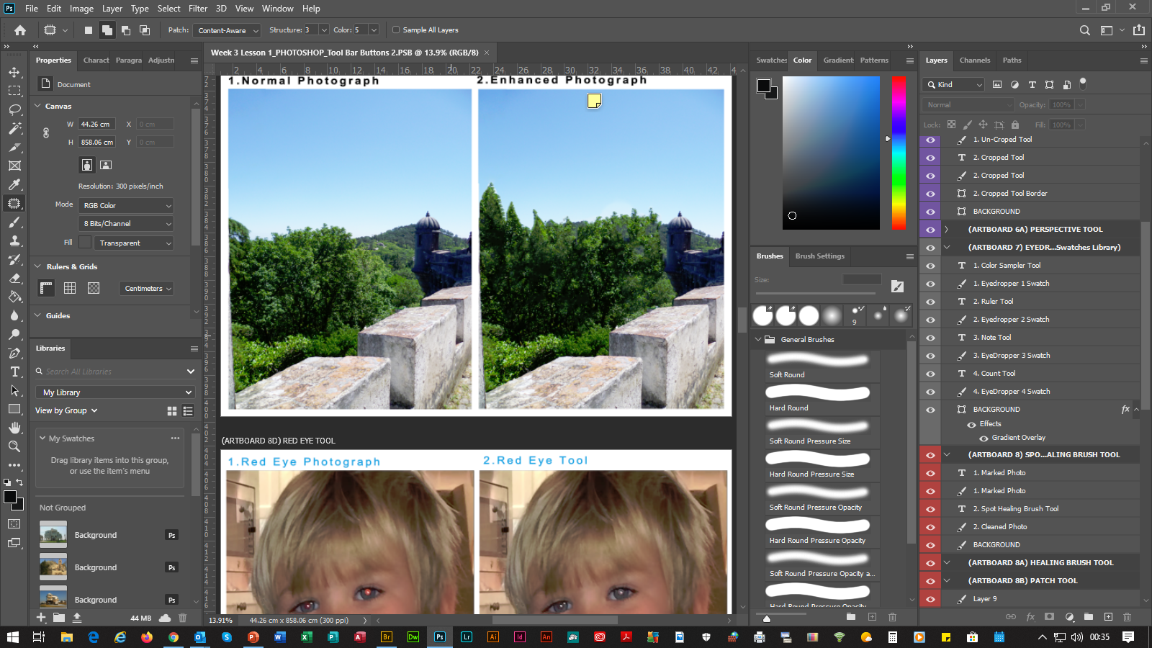

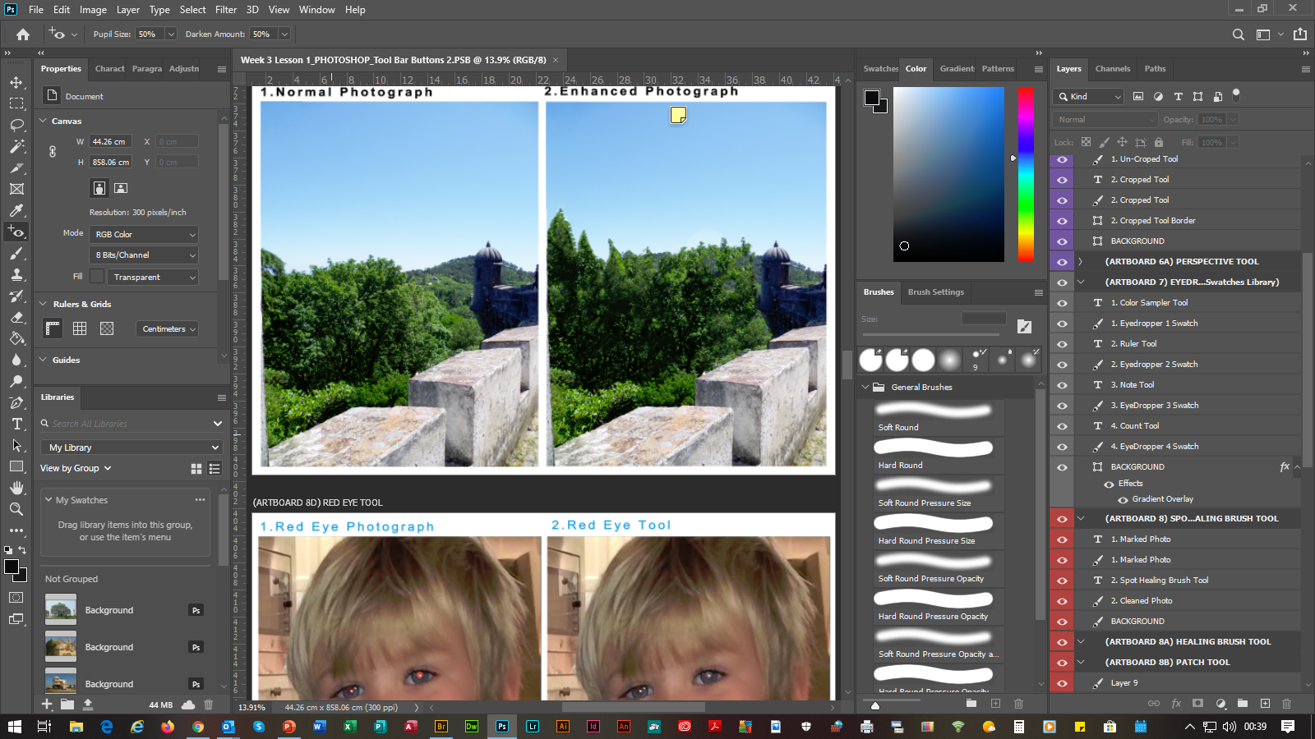
ADVANCED PHOTOSHOP 2020
(SLIDE 8) |  |  | (4. RE-TOUCHING TOOLS)
8. | Spot Healing Brush Tool |  |  |  |  | Removes Blemishes & Minor Marks By Selecting The Left Handle Of The Mouse & Moving The Line Over The Area(s). | Removes Blemishes By Selecting The Left Handle Of The Mouse & Moving The Line Over The Area(s).
 | 8.1 | Healing Brush Tool |  |  |  | Extracts A Sample From A Selected Area By Selecting The Left Handle Of The Mouse, Then Selecting The ALT KEY, Then Moving The Extraction Over The Area(s).
 | 8.2 | Patch Tool |  | Repairs Imperfections In A Selected Area By Using A Sample Or Pattern. Especially Useful For Using The Rectangular Marquee Tool, If The Far Edge(s) Need To Be Repaired, Then The Edges Will Remain Straight.
 | 8.3 | Content-Aware Move Tool |  |  |  |  |  | Builds Photographs Up By Duplicating Contents To Give A Fuller Picture. Can Also Remove Parts Of Pictures & Replace Them With The Original Scenery.
 | 8.4 | Red Eye Tool |  |  | Removes Red Eye From Photographs.
C
C
C
P
P

Slide 11
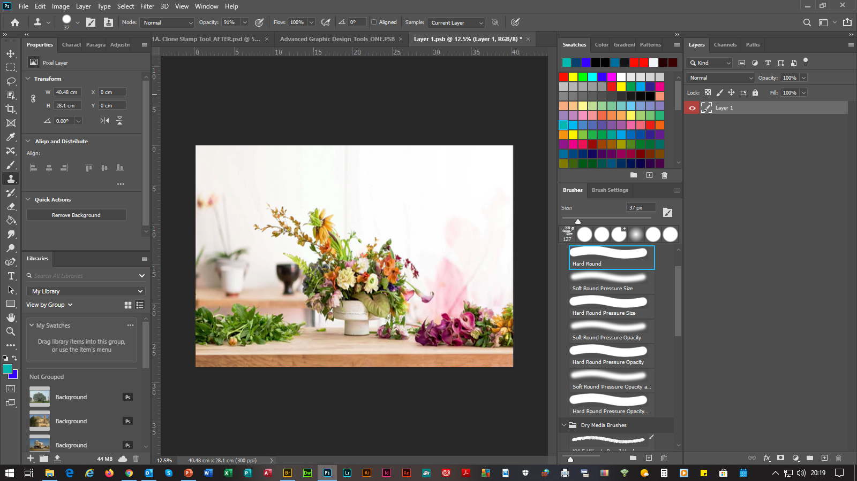
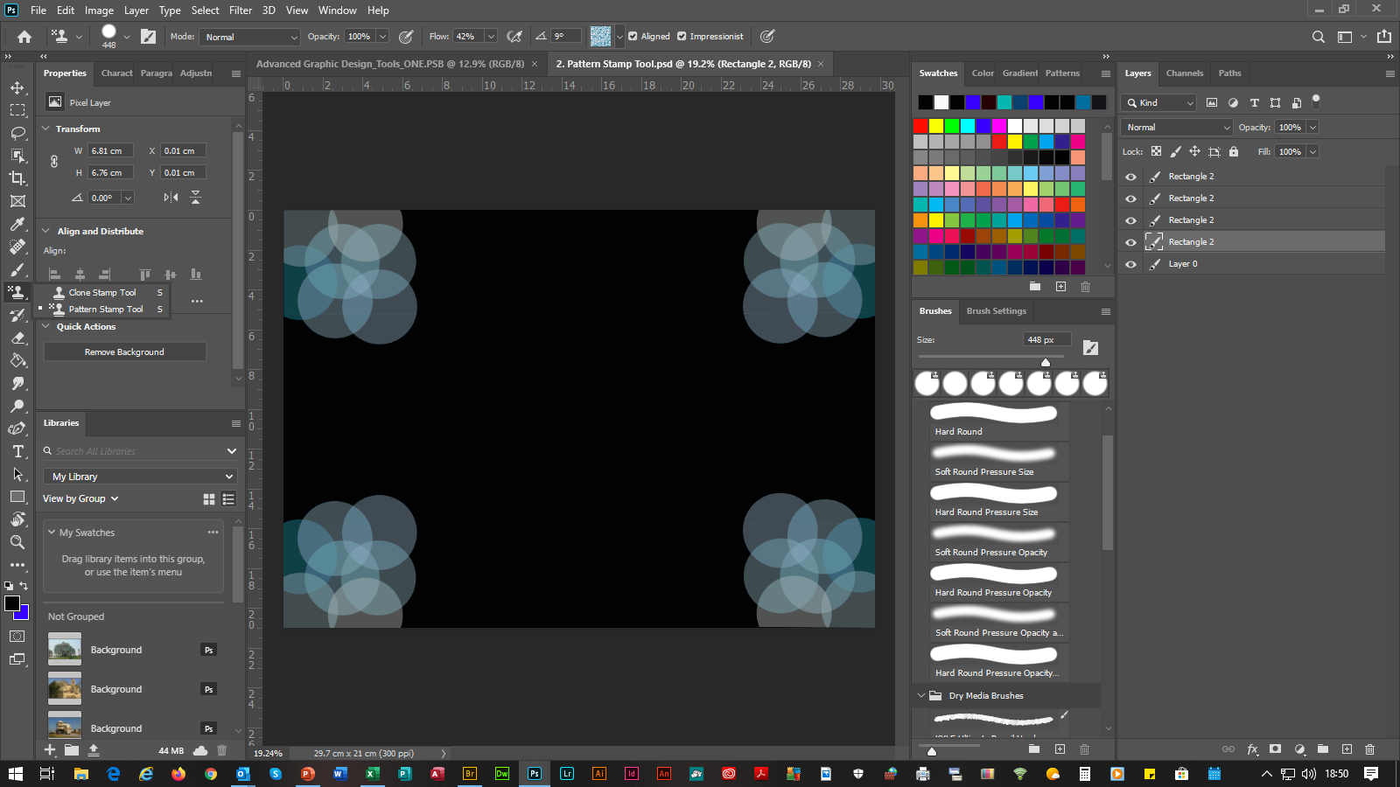
ADVANCED PHOTOSHOP 2020
(SLIDE 9) |  |  | (4. RE-TOUCHING TOOLS)
9. | Clone Stamp Tool |  |  | Similar To The Healing Brush Tool & Content-Aware Move Tool, As It Extracts Source Areas & Paints Them, But, As With The Healing Brush Tool You Need To Use The ALT KEY To Select The Source, Whereas, With The Content-Aware Move Tool You Move The Source.
 | 9.1 | Pattern Stamp Tool |  |  | Paints Using A Chosen Patten(s), Which Can Be Used For Repairing & Also For Enhancements & Design Background Layouts, Using The Pattern Presets Selections, By Selecting The Brush Size Pixel Selection From The Brush Preset Picker Dialog Box.
C
C
C
P
P

Slide 12
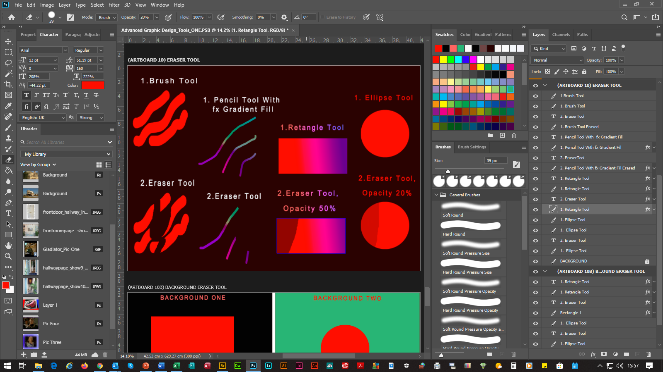
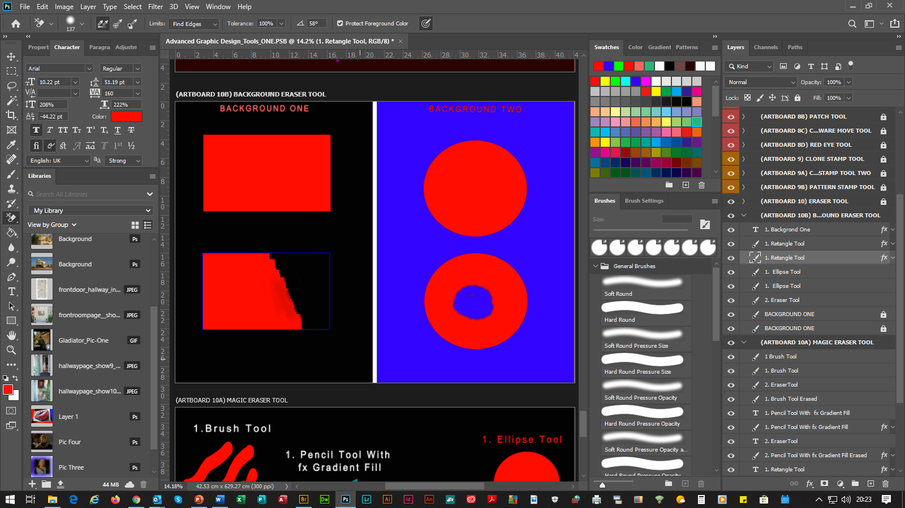
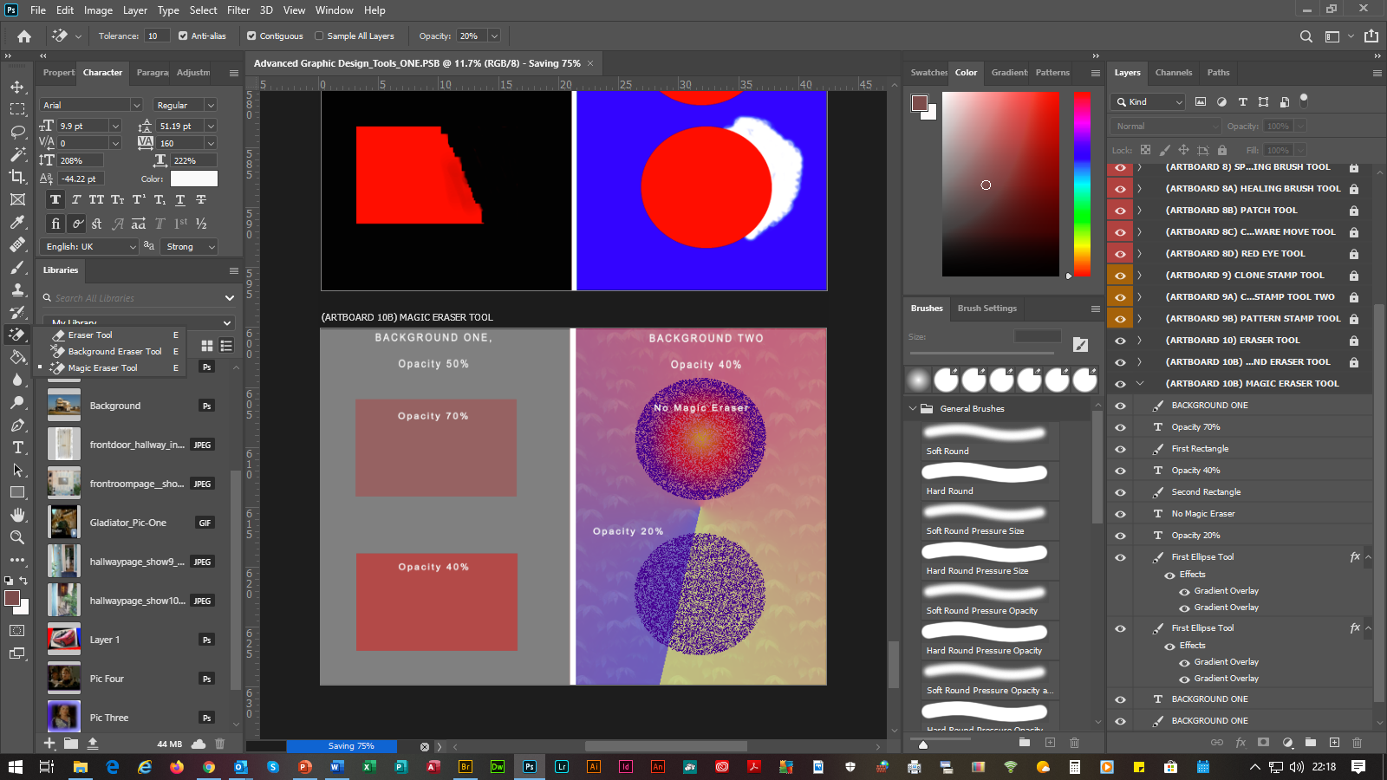
ADVANCED PHOTOSHOP 2020
(SLIDE 10) |  |  | (4. RE-TOUCHING TOOLS)
10. | Eraser Tool |  |  | Erases Brush & Pencil Tool Strokes, Color Fills & Gradient Fills From The fx Function From Either The Rectangular & Marquee Tools & Sub-Tools To The Background Color & Can Also Adjust The Density By Using The Opacity Tool. N.B. The Block Eraser From The Mode Selections Is The Favourable Tool.
 | 10.1 | Background Eraser Tool |  |  |  | Erases The Above Back To Background Color & Can Also Work Vise Versa By Selecting The Protect Foreground Check-Box & Selecting The Find Edges Within The Limits Selections.
 | 10.2 | Magic Eraser Tool |  |  | Erases The Above In Levels, I.E. By Selecting The Tolerance Level, Then The Contiguous Check-Box, Then The Opacity Tool.
C
C
C
P
P

Slide 13
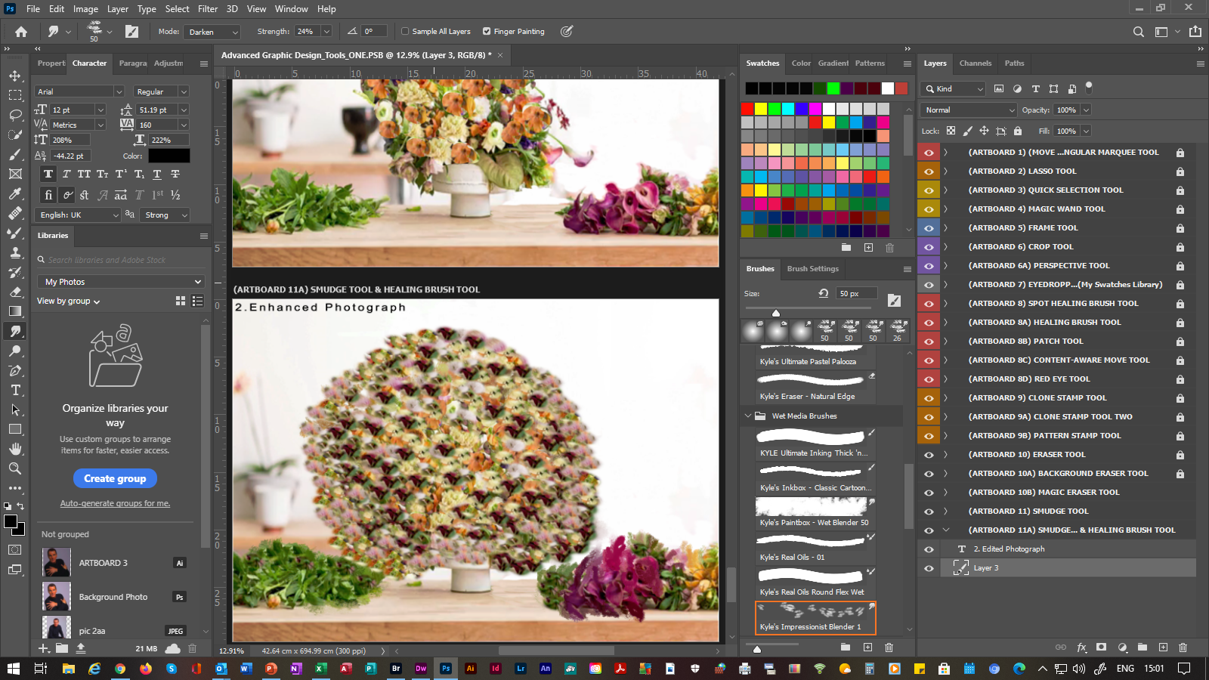
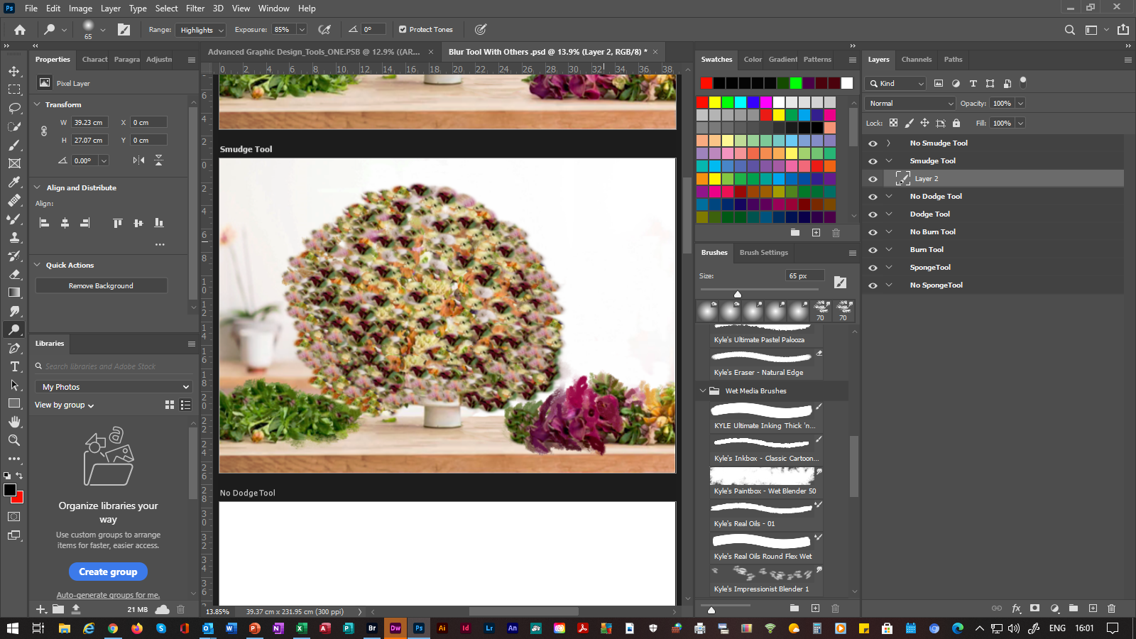
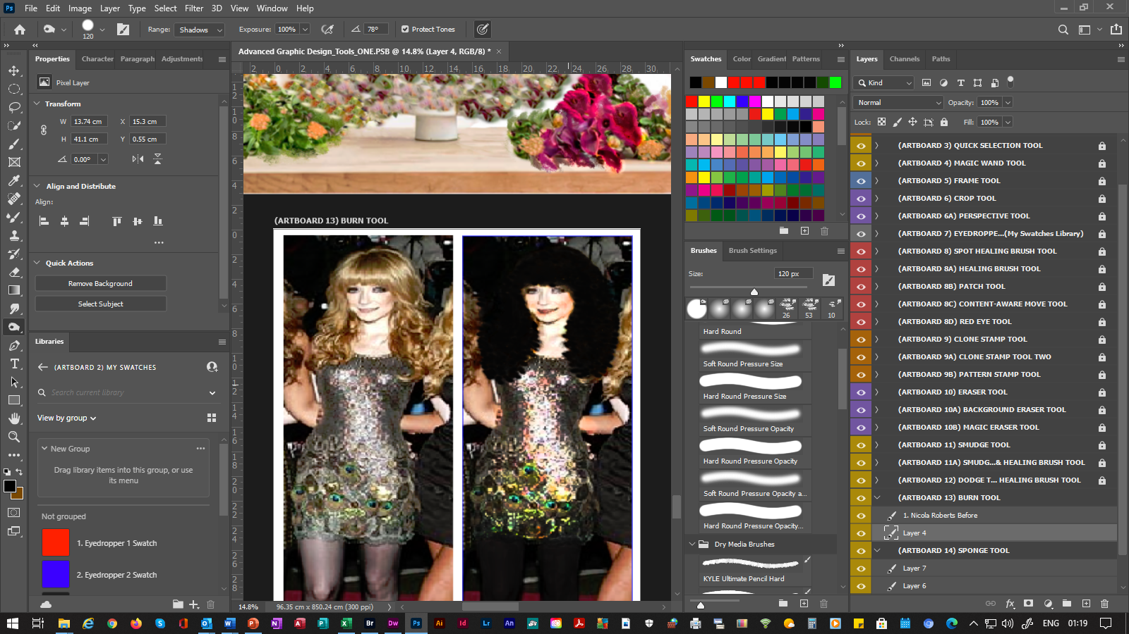
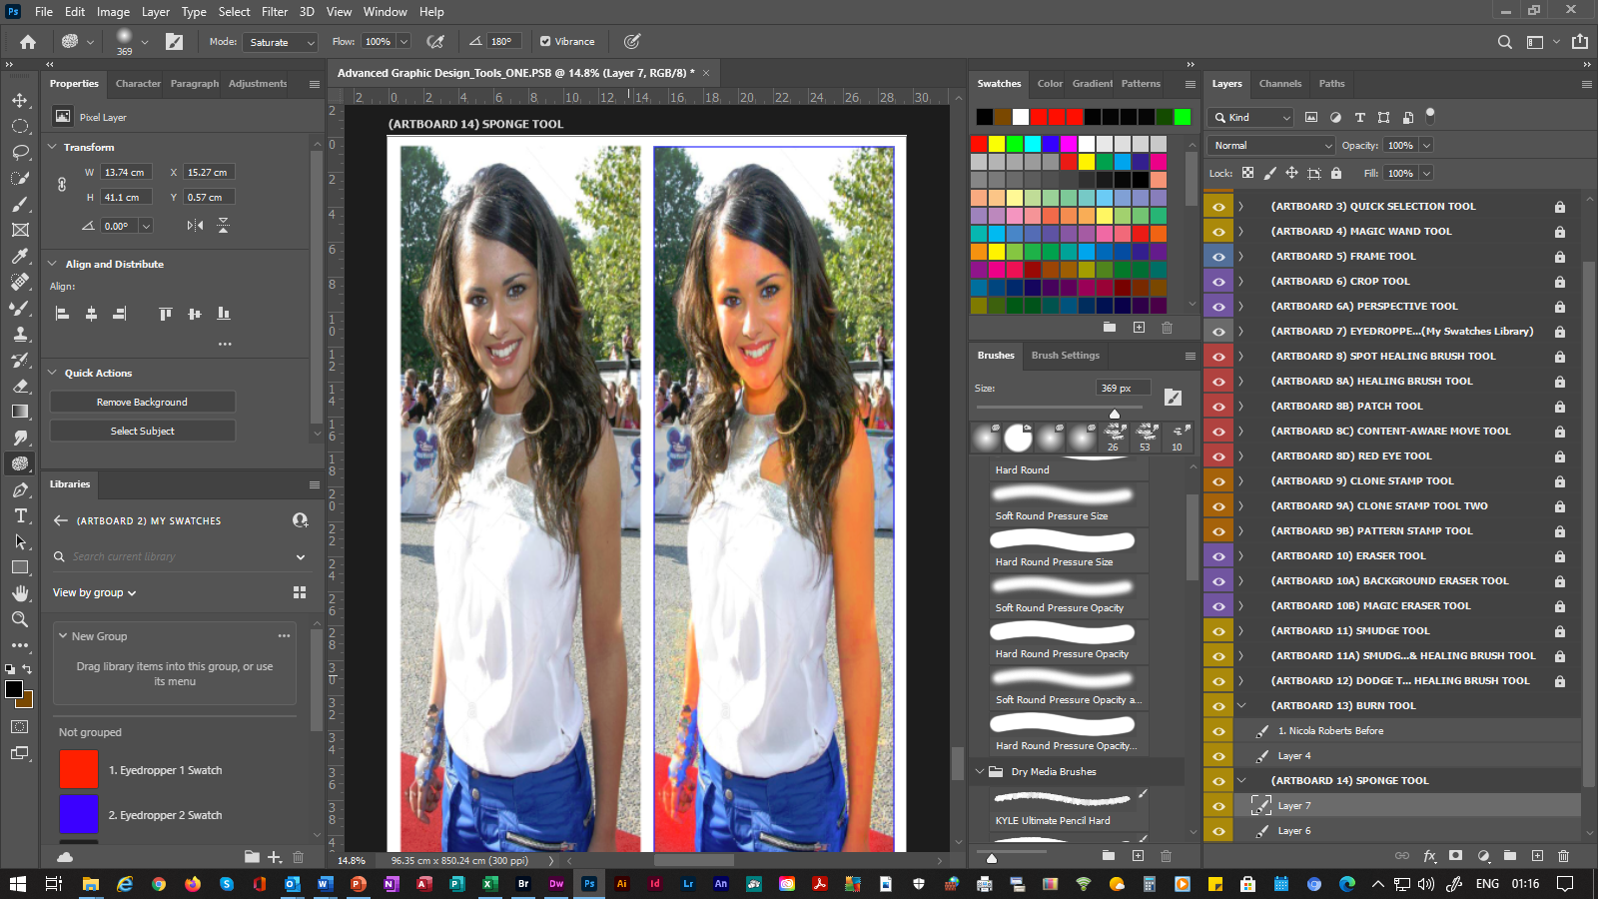
ADVANCED PHOTOSHOP 2020
(SLIDE 11) |  |  | (4. RE-TOUCHING TOOLS)
11. | Smudge Tool |  |  | Adds Colors & Shades To Existing Colors) .
 | 11.1 | Dodge Tool |  |  |  | Adds Lighter Shades To Existing Colors) . | Adds Enhanced Lighter Shades Making Pictures & Photographs Fuller.
 | 11.2 | Burn Tool |  |  | Adds Darker Shades To Existing Colors) .
 | 11.3 | Sponge Tool |  |  |  |  | Changes The Color Saturation To Existing Colors) .
C
C
C
P
P

Slide 14
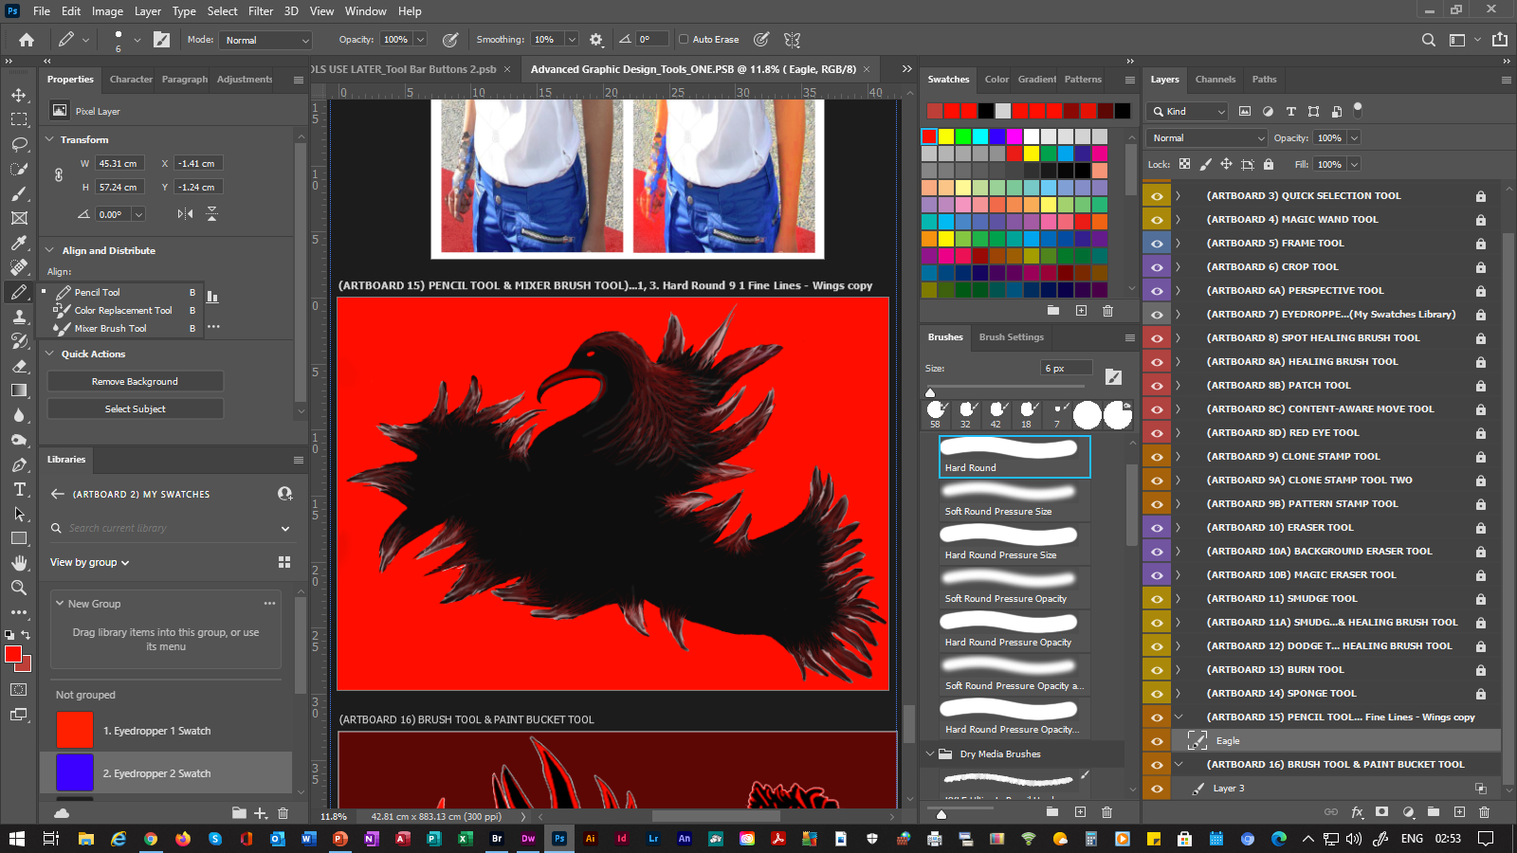
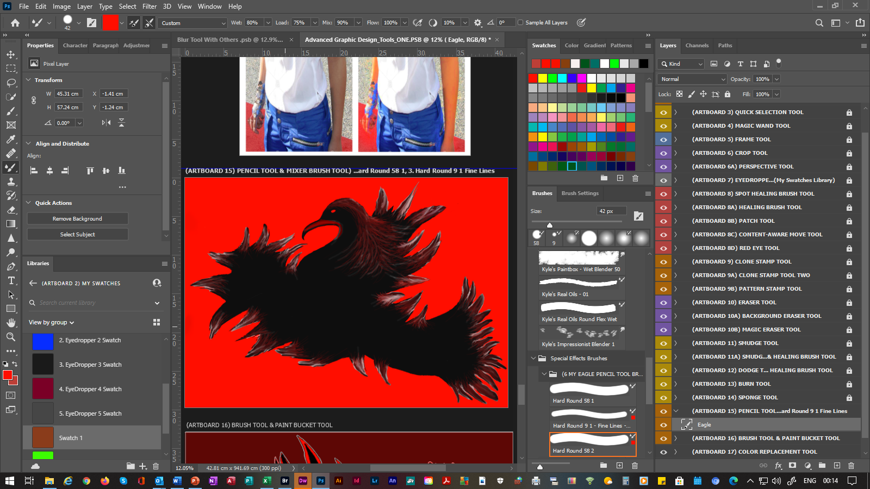
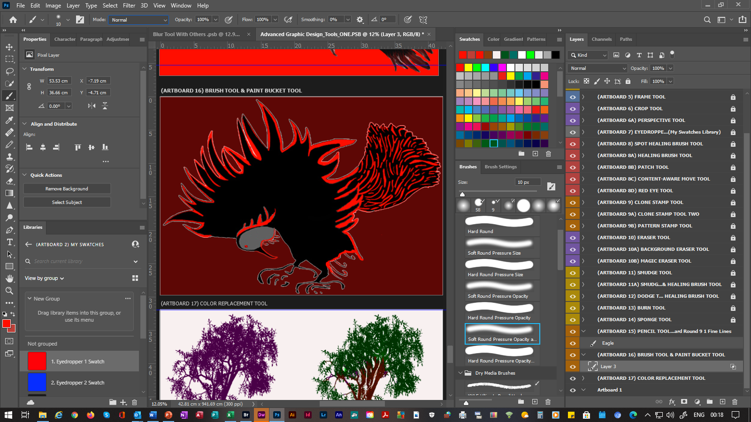
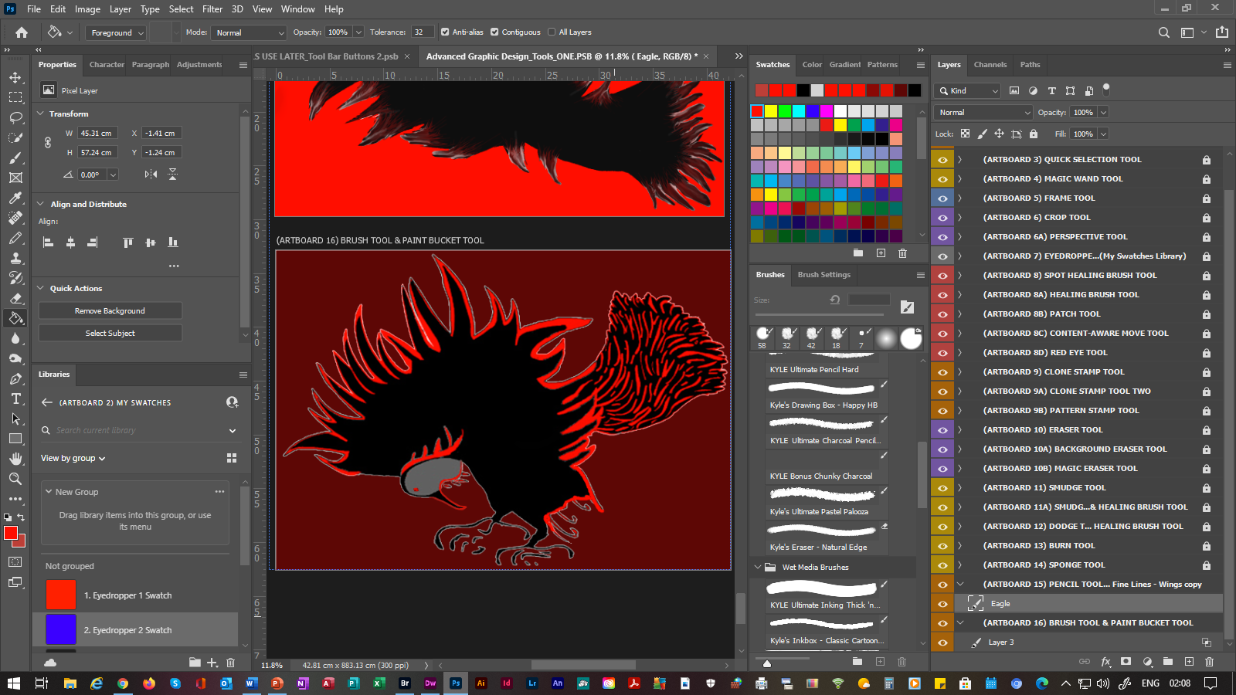
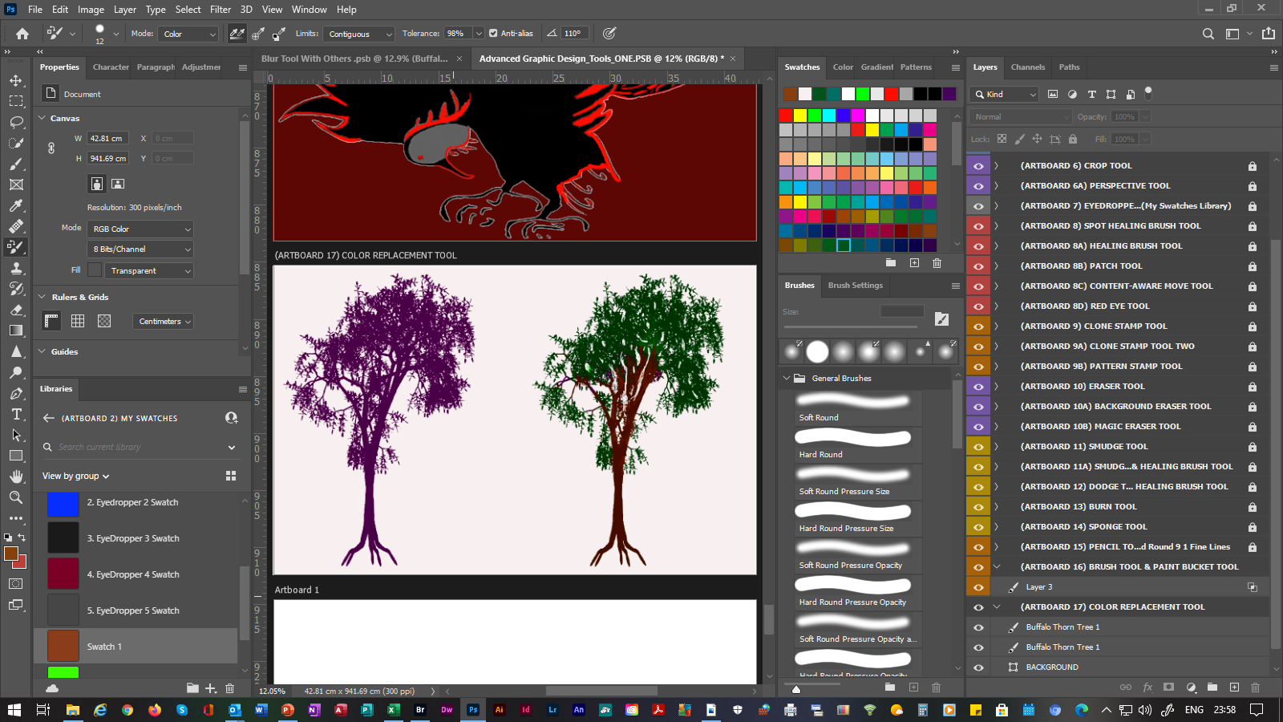
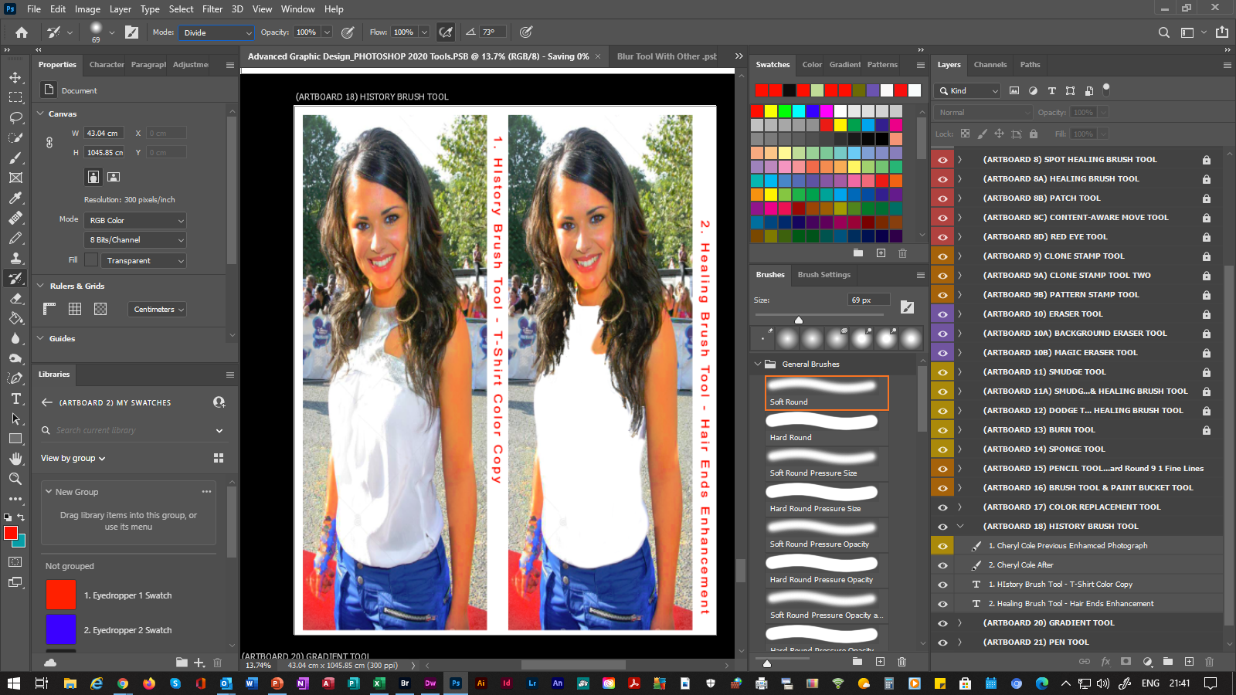
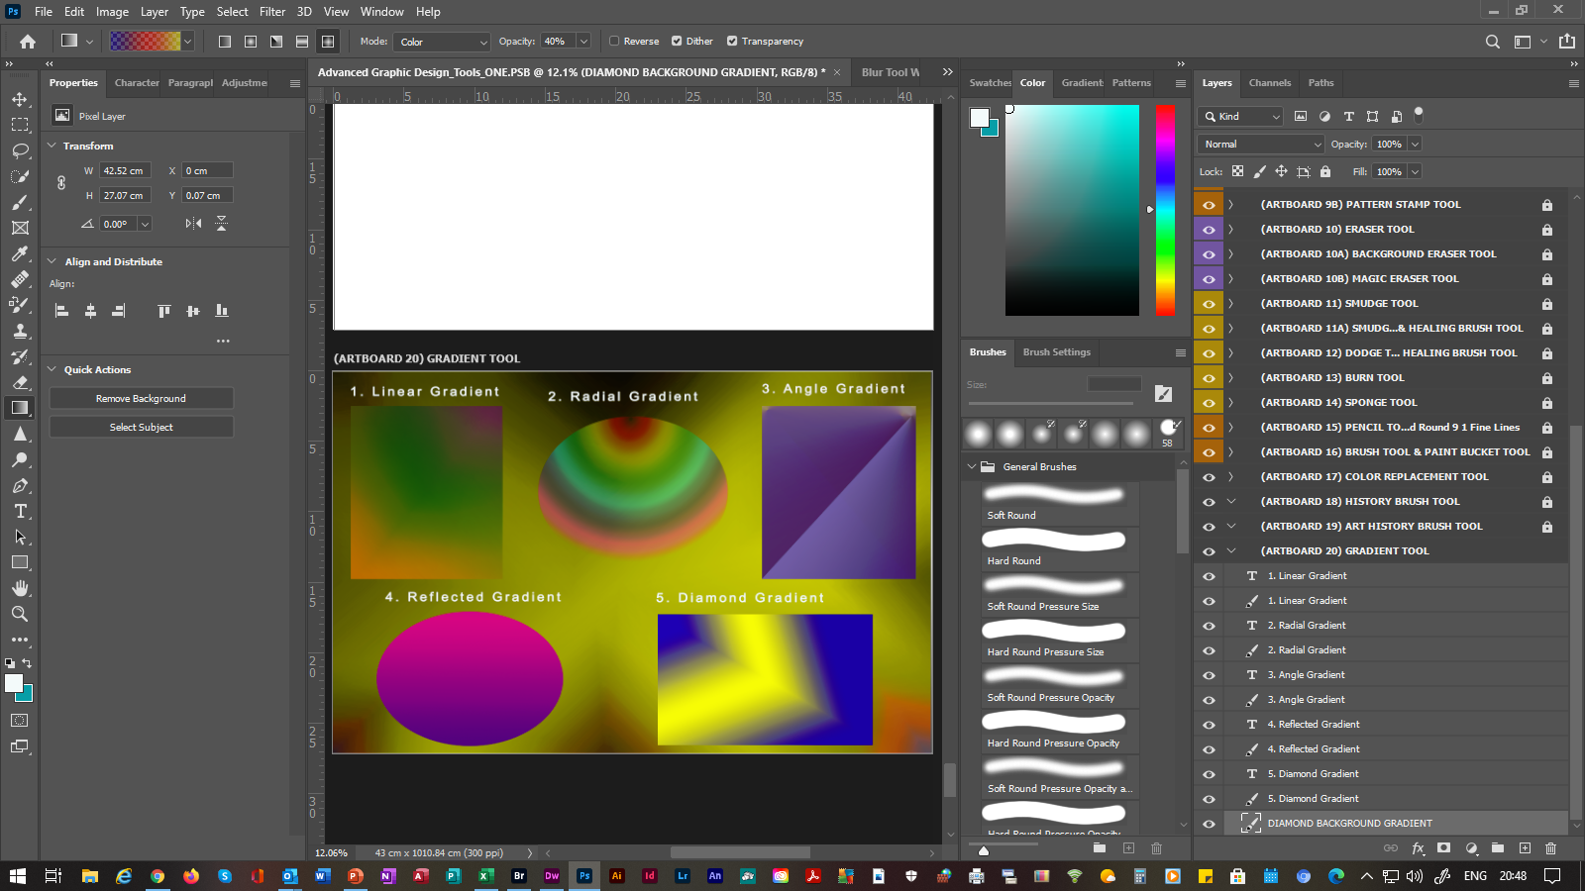
ADVANCED PHOTOSHOP 2020
(SLIDE 12) |  |  | (5. PAINTING TOOLS)
12. | Pencil Tool |  |  | Paints Smooth Edged Strokes.
 | 12.1 | Mixer Brush Tool |  |  |  |  | Mixes & Blends Colors Within Other Colors. (Example Included With Above Screen Print)
 | 12.2 | Brush Tool |  |  | Paints Brush Strokes.
 | 12.3 | Paint Bucket Tool |  |  |  |  | Fills Selected Areas With Foreground Colors. (Example Included With Above) | Applies Colors Or Replaces Colors With Other Colors . (Example Included With Above Screen Print) | Fills Selected Areas With Foreground Colors. (Example Included With Above)
 | 12.4 | Color Replacement Tool |  |  |  |  |  |  |  | Replaces A New Color Over An Existing Colors. | Replaces A New Color Over An Existing Color.
 | 12.5 | History Brush Tool |  |  |  |  |  |  | Paints A Copy Of A Color Section Into The Current One.
 | 12.6 | Gradient Tool |  |  |  | Creates Linear, Radial, Angle, Reflected & Diamond Blends Within Shapes By Using The (fx Function Button’s Options), Within The Layers Panel.
C
C
C
P
P

Slide 15
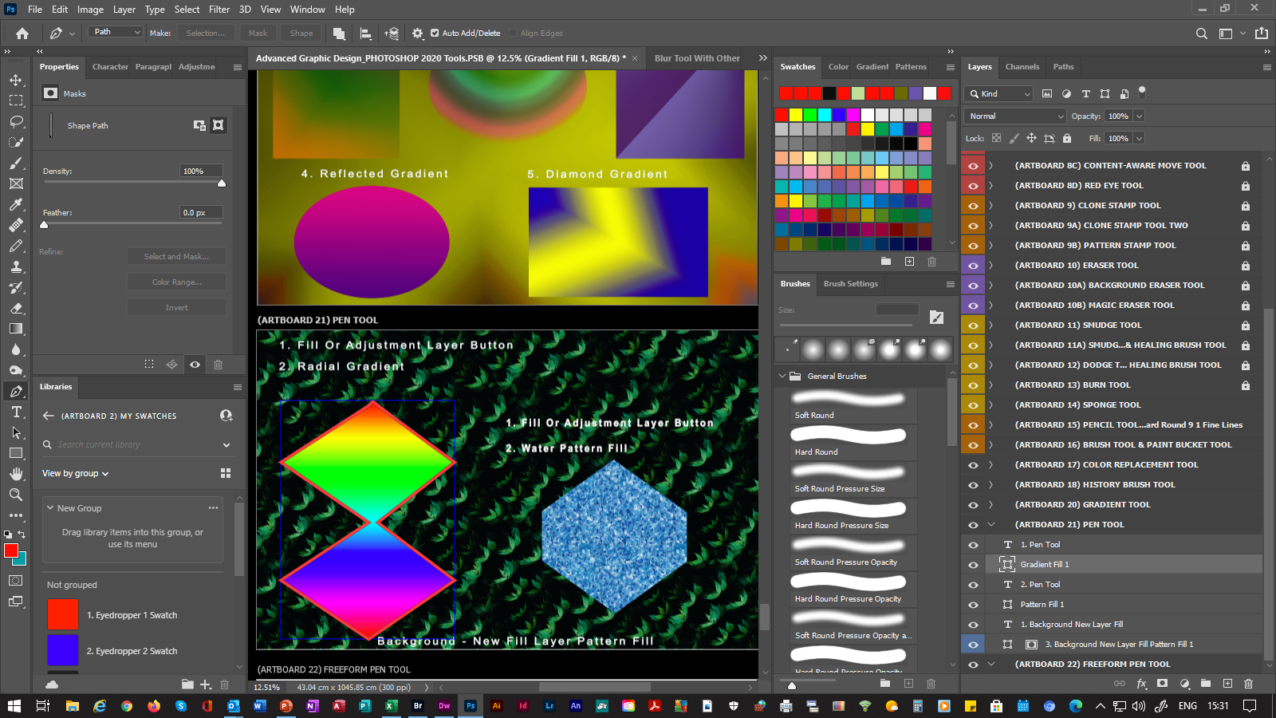
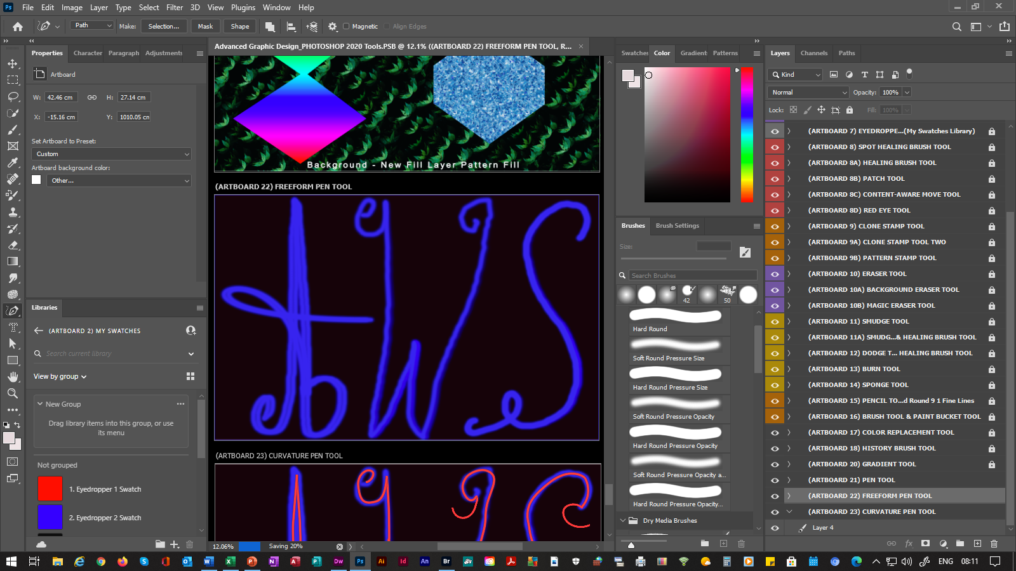
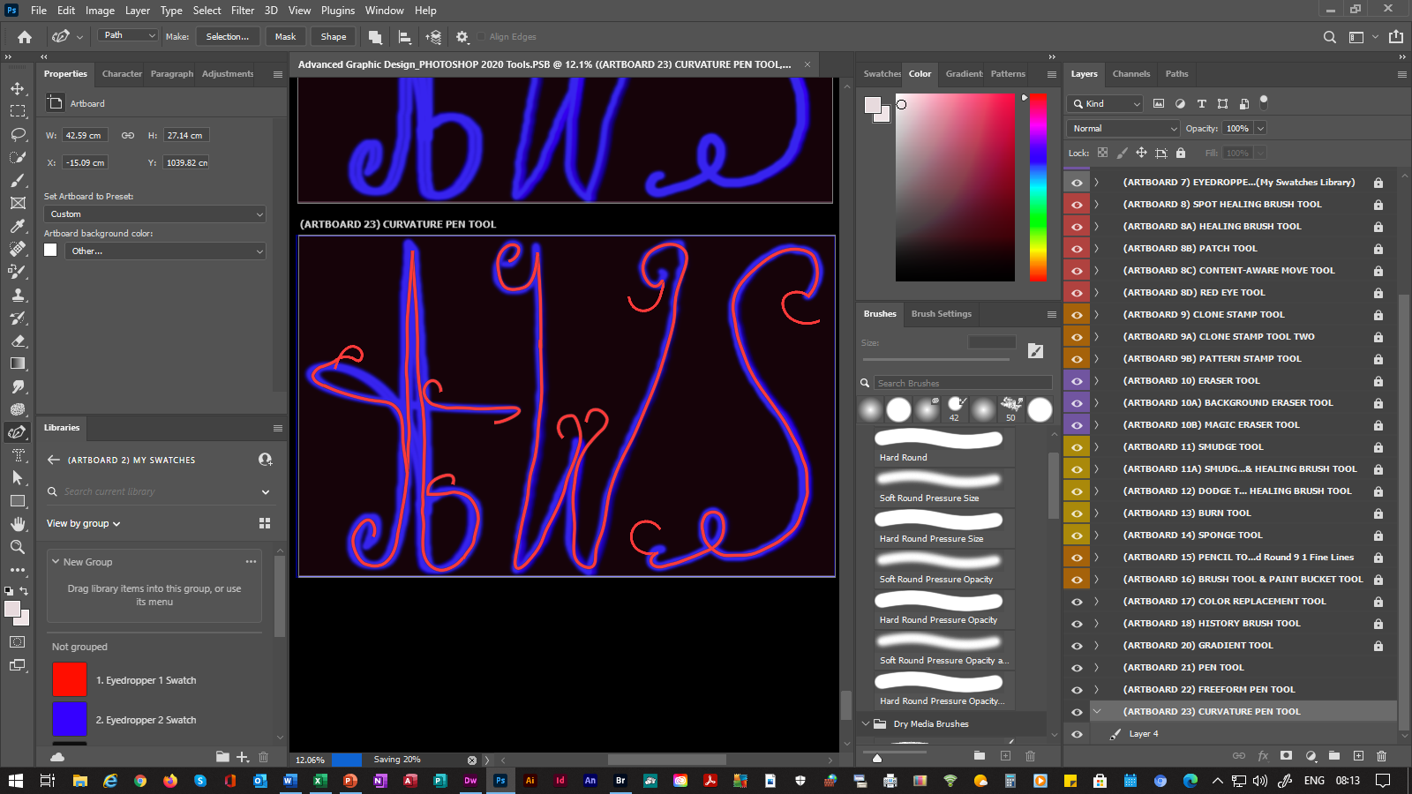
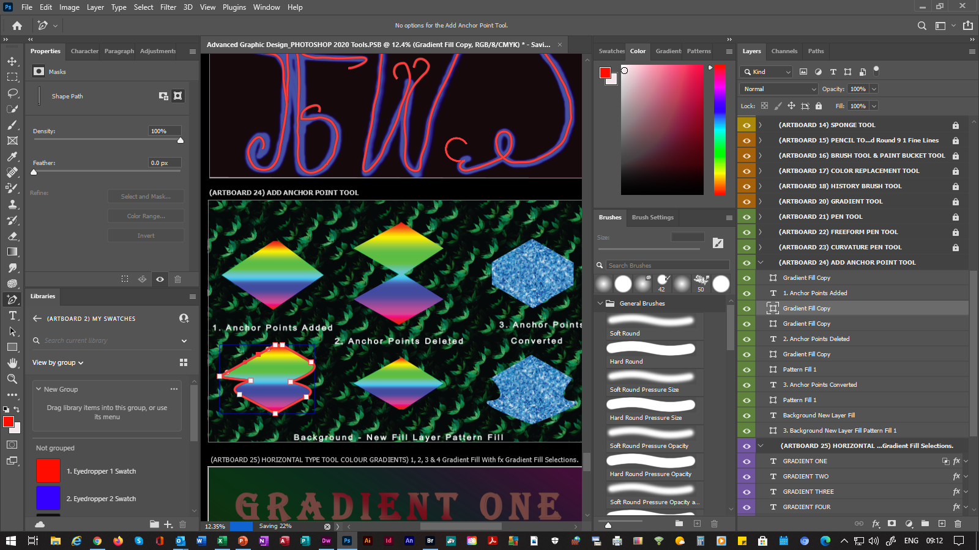

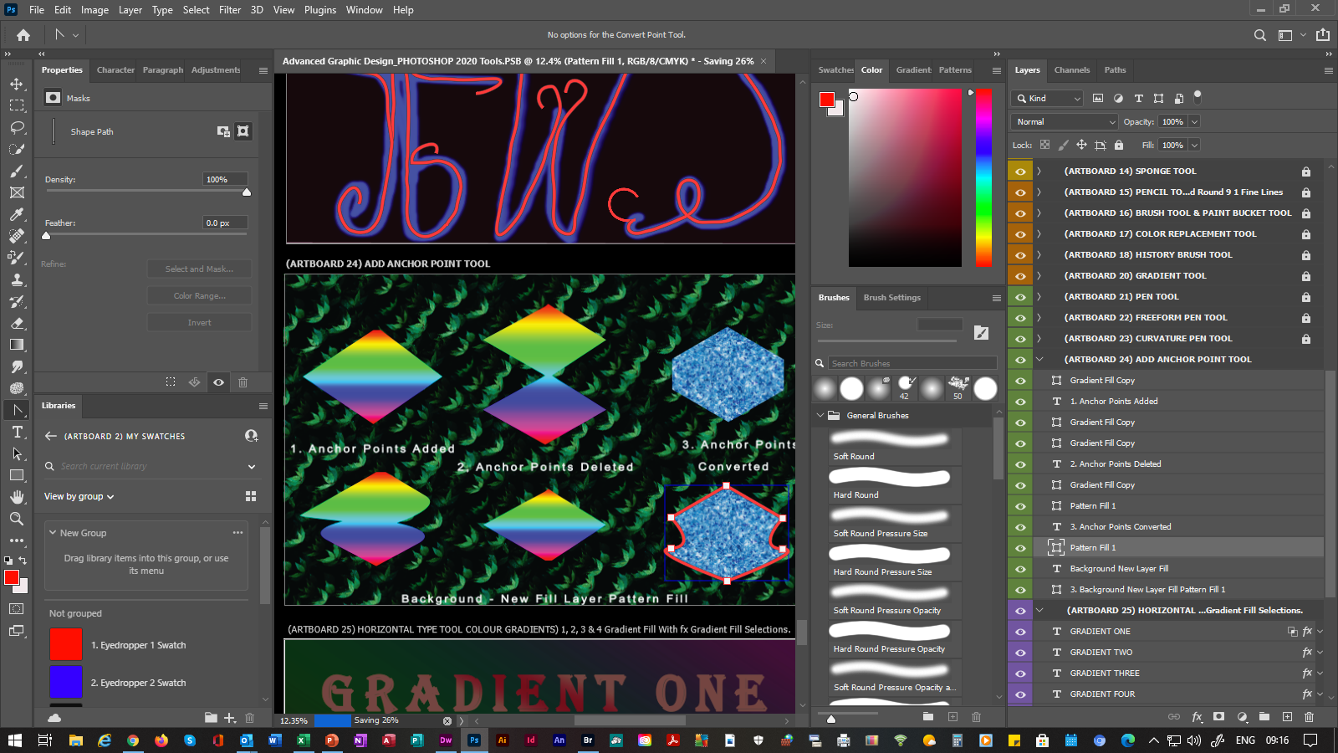
ADVANCED PHOTOSHOP 2020
(SLIDE 13) |  |  | (6. DRAWING TOOLS)
13. | Pen Tool |  | Draws Straight & Curved Connected Strokes. N.B. (AFTER SHAPE COMPLETE) Select The Right Handle Of The Mouse, Then Select Fill Path Or Stroke Path To Add Color, Then Select The Create New Fill Or Adjustment Layer Button From The Layers Panel.
 | 13.1 | Freeform Pen Tool |  | Draws Freeform Strokes & Curves. Can Also Be Used Like The Pen Tool By Using The Magnetized Check-Box Option.
 | 13.2 | Curvature Pen Tool |  |  | Draws Straight & Curved Connected Strokes, Which Are Useful For Sketching & Highlighting Art Work, Then By Using The Path Selection Tool To Move Strokes & The Direct Selection Tool To Re-Shape Strokes. (Example Included With Above Screen Print)
 | 13.3 | Add Anchor Point Tool |  |  |  | Adds Anchor Points, To Enable Shape Changes To All Of The Above Tools.
 | 13.4 | Delete Anchor Point Tool |  |  |  |  | Deletes Anchor Points, To Enable Shape Changes To All Of The Above Tools.
 | 13.5 | Convert Point Tool |  |  | Converts Anchor Points, To Enable Shape Changes To All Of The Above Tools. (Examples Included With Above Screen Print)
C
C
C
P
P

Slide 16
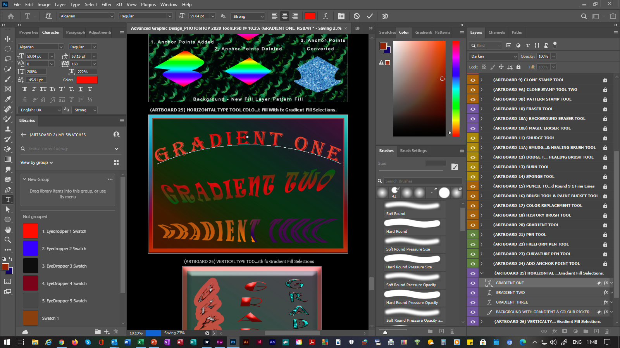
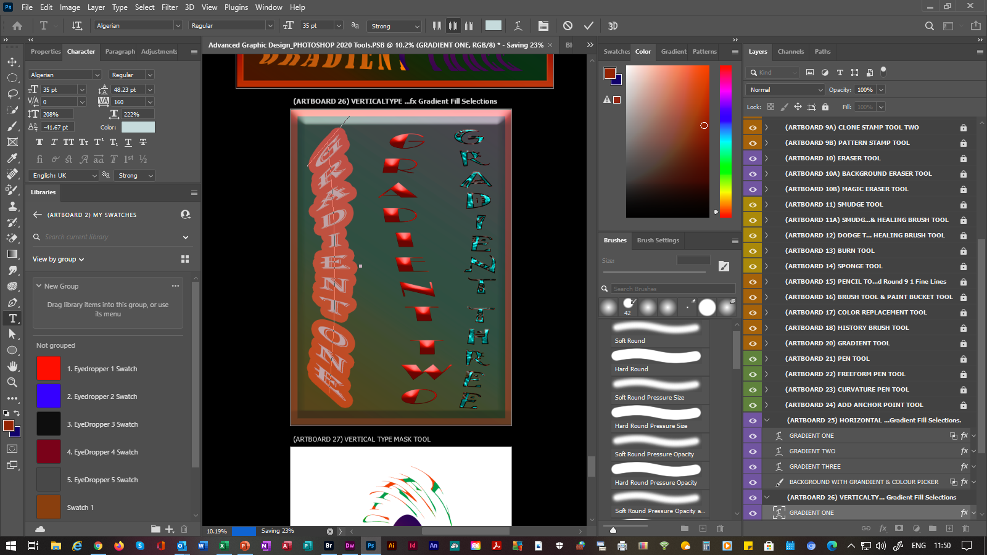
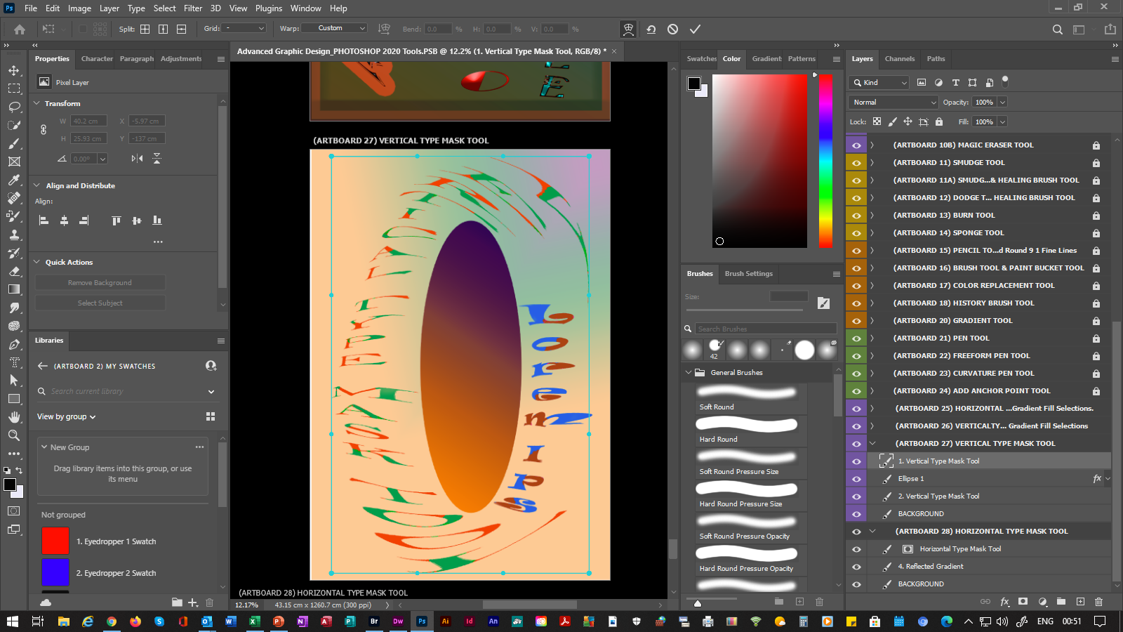

ADVANCED PHOTOSHOP 2020
(SLIDE 14) |  |  | (7. TYPE & DRAWING TOOLS)
14. | Horizontal Type Tool |  |  | Creates Horizontal Type On Or Around Drawings, Photographs & Shapes.
 | 14.1 | Vertical Type Tool |  |  | Creates Vertical Type On Or Around Drawings, Photographs & Shapes.
 | 14.2 | Vertical Type Mask Tool |  |  |  | Creates Vertical Type Selection On Or Around Drawings, Photographs & Shapes, Using Points To Acquire The Curves & Shape.
 | 14.3 | Horizontal Type Mask Tool |  |  |  |  | Creates Horizontal Type Selection On Or Around Drawings, Photographs & Shapes, Using Points To Acquire The Curves & Shape.
C
C
C
P
P

Slide 17






ADVANCED PHOTOSHOP 2020
(SLIDE 15) |  |  | (7. TYPE & DRAWING TOOLS)
15. | Rectangle Tool |  |  | Draws Rectangle Shapes.
 | 15.1 | Rounded Rectangle Tool |  |  |  |  |  |  | Draws Rounded Rectangle Shapes.
 | 15.2 | Ellipse Tool |  |  |  | Draws Circular & Oval Shapes. |  |  | Creates
 | 15.3 | Polygon Tool |  |  |  |  | Draws Polygon Shapes.
 | 15.4 | Line Tool |  |  | Draws Line Shapes.
 | 15.5 | Custom Shape Tool |  |  |  |  |  | Draws Custom Shapes From A Stored Picture List. (Examples Included With Above Screen Print)
C
C
C
P
P

Slide 18


ADVANCED PHOTOSHOP 2020
(SLIDE 16) |  |  | (7. TYPE & DRAWING TOOLS)
16. | Path Selection Tool |  |  | Moves Drawings, Photographs & Shapes Around The Canvas.
 | 16.1 | Direct Selection Tool |  | Draws Rounded Rectangle Shapes. | Re-Shapes Drawings, Photographs & Shapes. (Example Included With Above Screen Print)
C
C
C
P
P

Slide 19



ADVANCED PHOTOSHOP 2020
(SLIDE 17) |  |  | (8. NAVIGATION TOOLS)
17. 17.A | Hand Tool Hand Tool |  |  | Enables The Artboard(s) To Be Moved Around & Positioned Accordingly. Enables The Artboard(s) To Be Enlarged By Selecting The CTRL KEY & Selecting The Left Handle Of The Mouse. Enables The Artboard(s) To Be Reduced By Selecting The ALT KEY & Selecting The Left Handle Of The Mouse.
 | 17.1 | Rotate Tool |  |  |  | Enables The Artboard(s) To Be Rotated.
 | 17.2 | Zoom Tool |  |  | Enables The Artboard(s) To Be Enlarged. Enables The Artboard(s) To Be Reduced By Selecting The ALT KEY & Selecting The Left Handle Of The Mouse. | Draws Rounded Rectangle Shapes.
C
C
C
P
P

